Slide 1

PROCUREMENT PUNCHOUT CATALOGS

Slide 2
TOPICS OF DISCUSSION
Role of Procurement
Jaggaer System
Jaggaer Roles
Punchout Catalogs
Punchout Catalog Process
Amazon Punchout Benefits
Amazon Punchout Walk-Thru
Next Steps

Slide 3
ROLE OF PROCUREMENT
It is the strategic process that involves the purchase of goods and services.
Procurement Role:
Facilitates the purchase of goods and services prior to obtaining any goods and services.
Implements procurement tools, systems, and guidelines related to purchases on campus.
Sets up catalogs, contracts and/or punch out suppliers so that campus can purchase goods and services.
Facilitates formal competitive solicitation process.
Assists in negotiations with suppliers and securing the best pricing, delivery, and services.

Slide 4
JAGGAER SYSTEM
Jaggaer is an E-Procurement system that manages spend and procurement processes for TCU.
Benefits:
Strategic Sourcing
Tracking Spend
Punchout Catalogs
Faster Processing
Automated Approvals
Helps to minimize risk/fraud

Slide 5
JAGGAER ROLES
Jaggaer roles must be requested at: https://finance.tcu.edu/jaggaer-resources/access-request.php
Shopper Role – All employees are automatically assigned the shopper role within Jaggaer. Shoppers can create a cart but must assign their cart to a departmental requester to complete and submit the cart for purchase.
Requester/Submitter Role – Requesters can create requisitions, punchout catalog carts, submit the orders for processing, including carts assigned to them by other shoppers or approvers, and once goods are received, approve payment of the invoice.
Note: Requesters cannot approve their own purchases.
Approval Role – Ensure the following: the items on the requisition are for business use, an appropriate budget is being used, the items are authorized on that particular budget, and the requisition has the appropriate information in it prior to approval. If the purchase should not approved, the Approver can return the requisition back to the Requester.
Note: Approvers cannot be requesters or submit orders for processing.

Slide 6
PUNCHOUT CATALOGS
Punchout refers to a digital system in which a supplier allows customers to shop for products and then purchase the goods within TCU’s Jaggaer system.
Benefits:
Real-time and up-to-date stock, pricing, and delivery dates. Generally, it provides a typical online shopping experience.
Automatically fills out the requisition forms and efficiently goes through approval workflows.
TCU will provide the following two punchout suppliers:
Amazon
Staples
Note: More suppliers catalogs to come ☺

Slide 7
PUNCHOUT CATALOG PROCESS
Create the Pre-Approval Requisition
  Login to Jagger (every time) and launch the punchout from the tile
  Shop on the vendor site and complete the purchase to send the cart information to Jaggaer
  Verify all information and submit the cart for approval
Requisition Approval
  It is not yet “purchased” until this is fully complete
  Approval workflow (and the assigned folks) can be found on the requisition if it is time sensitive
  Once approvals are complete the system will automatically let the vendor know to complete the purchase
Invoice Approval
  Invoices will automatically come into Jaggaer from the vendor (usually shortly after shipping confirmation)
  The requester has a step to approve the invoice (as confirmation of receiving everything)
  Once the invoice workflow is complete the payment information will be sent to PeopleSoft to pay the vendor

Slide 8
AMAZON PUNCHOUT BENEFITS
TCU’s Business account provides the familiar online marketplace experience that shoppers have enjoyed for years including business specific benefits.
Benefits:
Automatically accounts for TCU tax exemption on orders
Business pricing, shipping, and quantity discounts on millions of items
Two-Day Shipping on millions of eligible items (Monday-Friday Deliveries)
The Department does not have to pay for an Amazon Business Prime Account.
Note: Accounts migrated to TCU’s account will be refunded a pro-rated amount
Dedicated Amazon Business Customer Service by clicking “Contact Us” from within TCU’s Amazon Business account or by calling 1-888-281-3847. Please use this team for anything related to an order, transaction, shipment, and general Amazon related inquires.

Slide 9
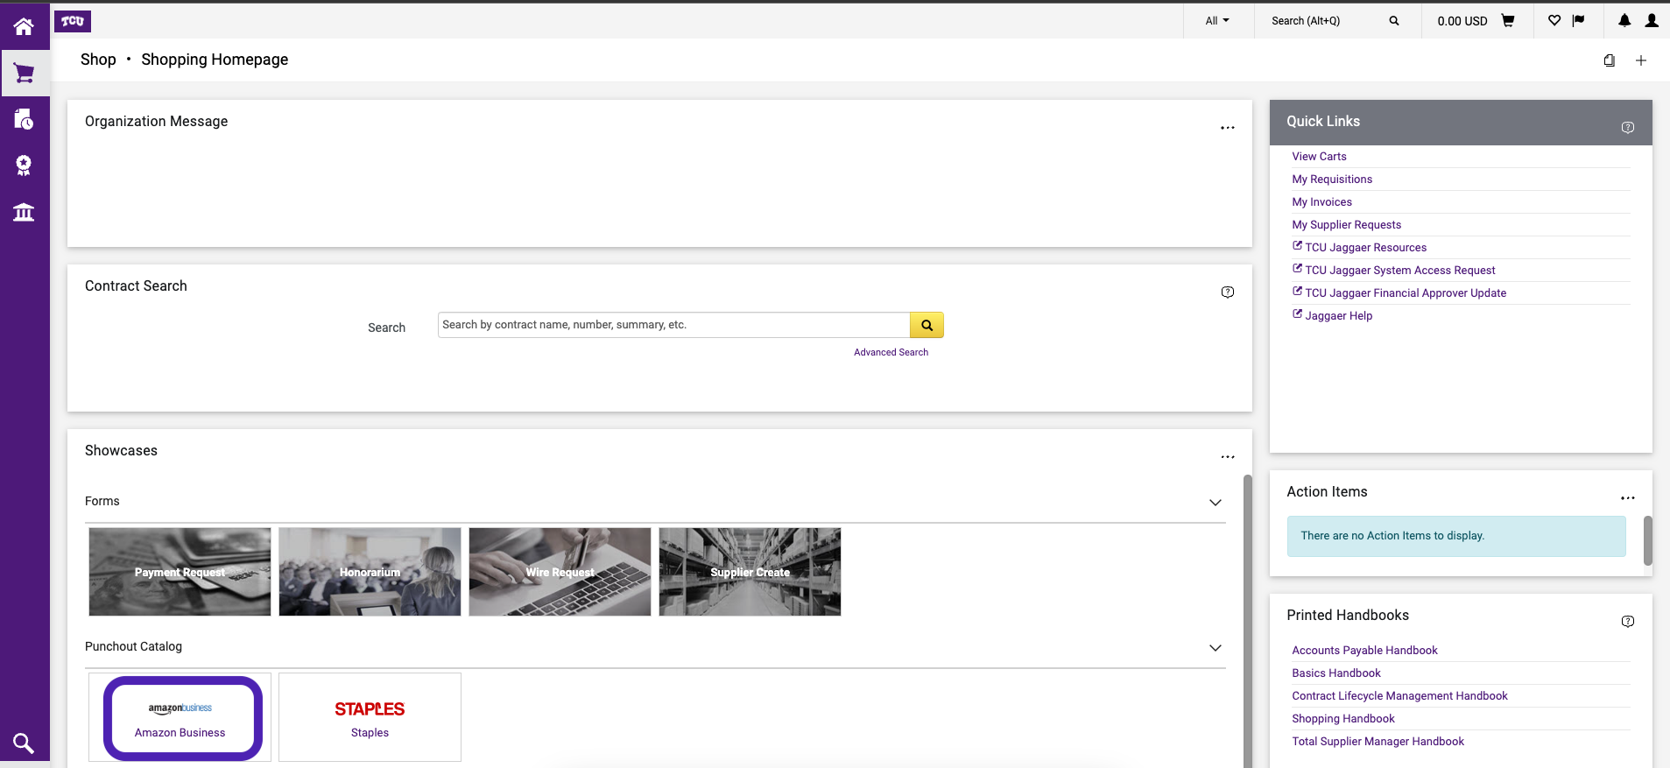
Step 1
Click on the punchout supplier and it will “punchout” to Amazon’s webpage. Only have 1 punchout session and do not have it open long.
Note: If it does not automatically open, make sure your pop-up blocker is disabled.

Slide 10
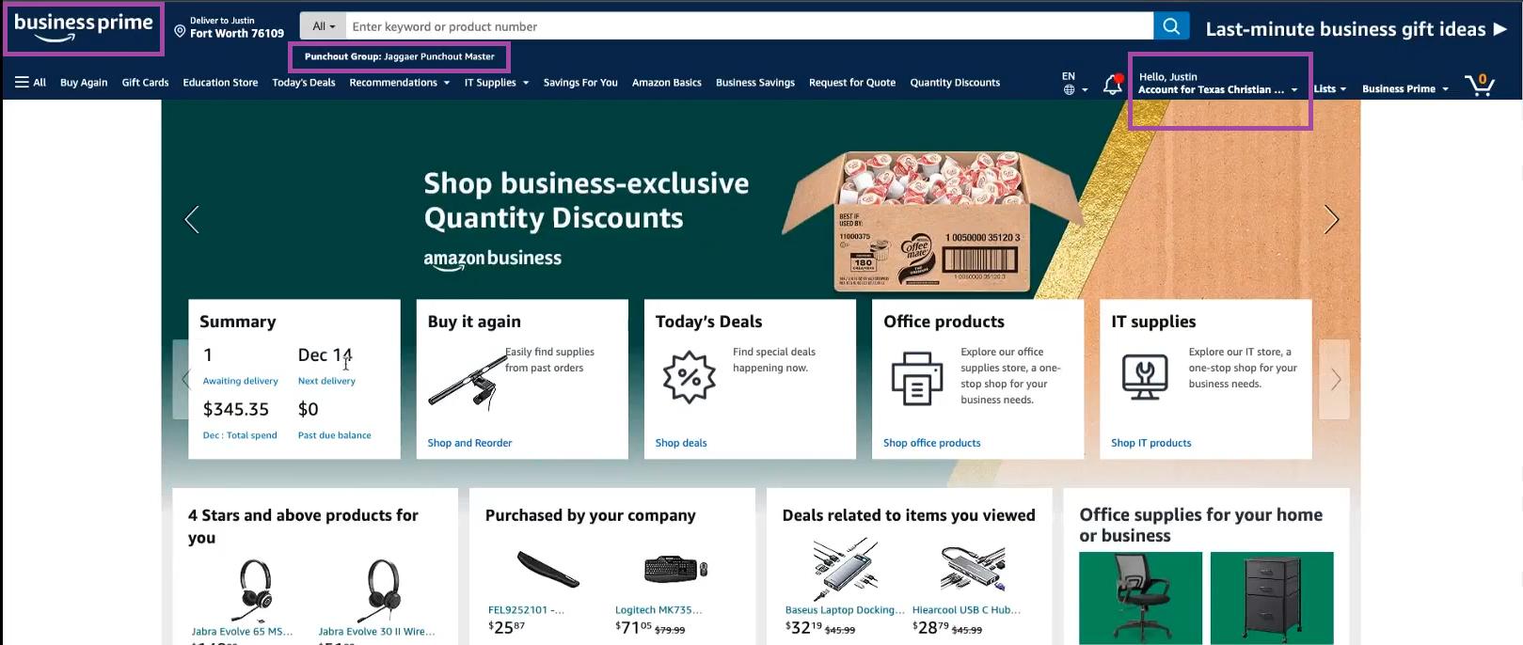
Step 2
Confirm the following is showing in your account:
Business Prime logo in top left
Underneath search engine, it shows ‘Jaggaer Punchout Master’
Hello XX, Account for Texas Christian University in top right

Slide 11
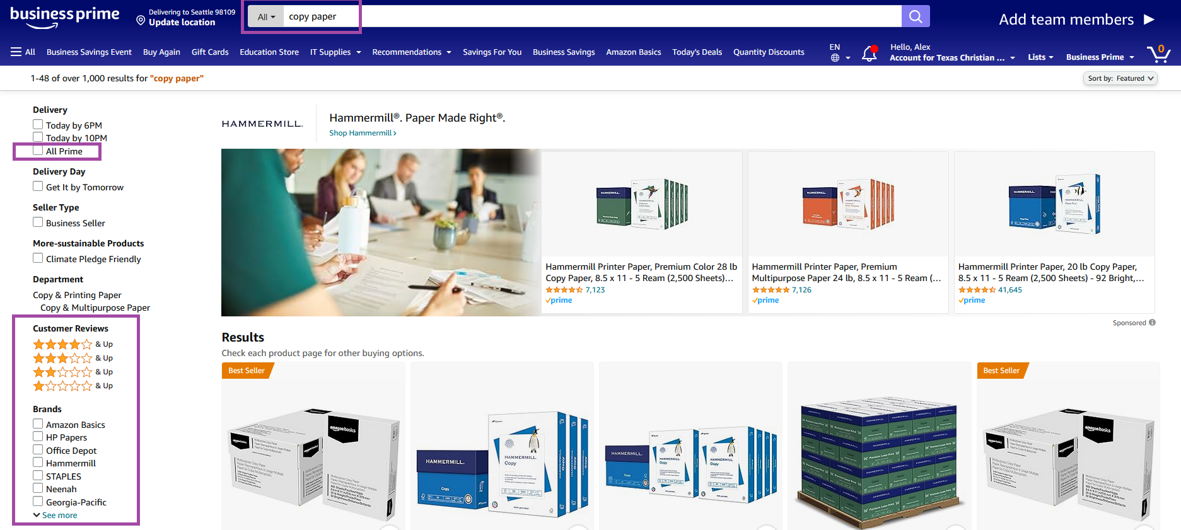
Step 3
Shop for items in search engine while applying filters on the left-side for example, “All Prime”, customer reviews, brand, etc.

Slide 12
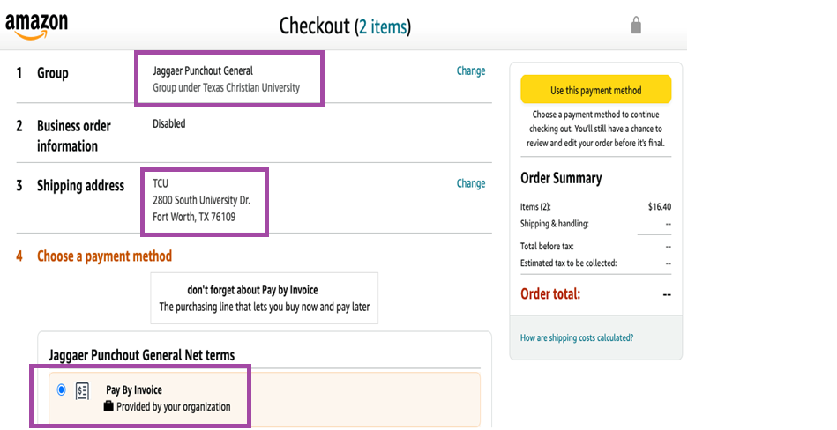
Step 4
Note: It will populate a generic shipping address and the only payment option is “Invoice”.
All staff will land in Jaggaer Punchout General group while IT staff will land in Jagger Punchout IT group
Select your ship-to address within Jaggaer
Select your ship-to address within Jaggaer
Default payment method is Pay by Invoice

Slide 13
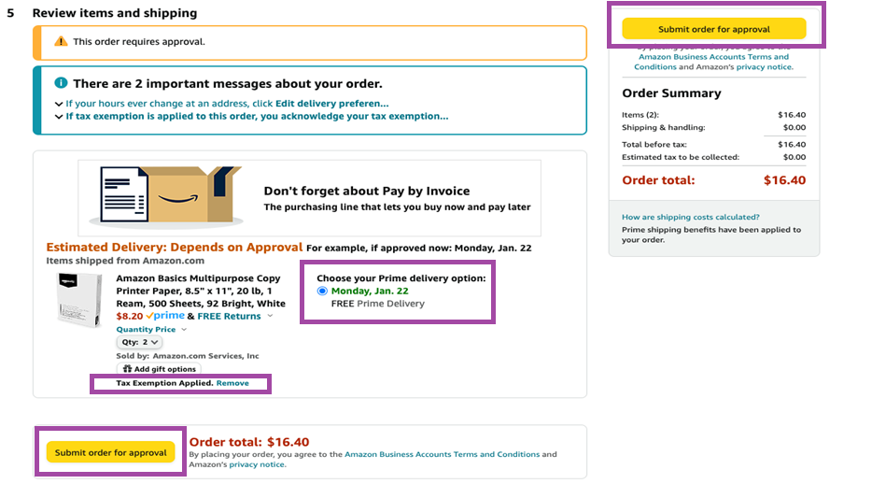
Step 5
Note: Select your delivery options and ensure tax exemption is applied to your items. Select ‘submit Order for approval’ once you’re ready to process order
Select your delivery options. Be sure to not select weekend days for delivery
Ensure your items are applying the tax exemption

Slide 14
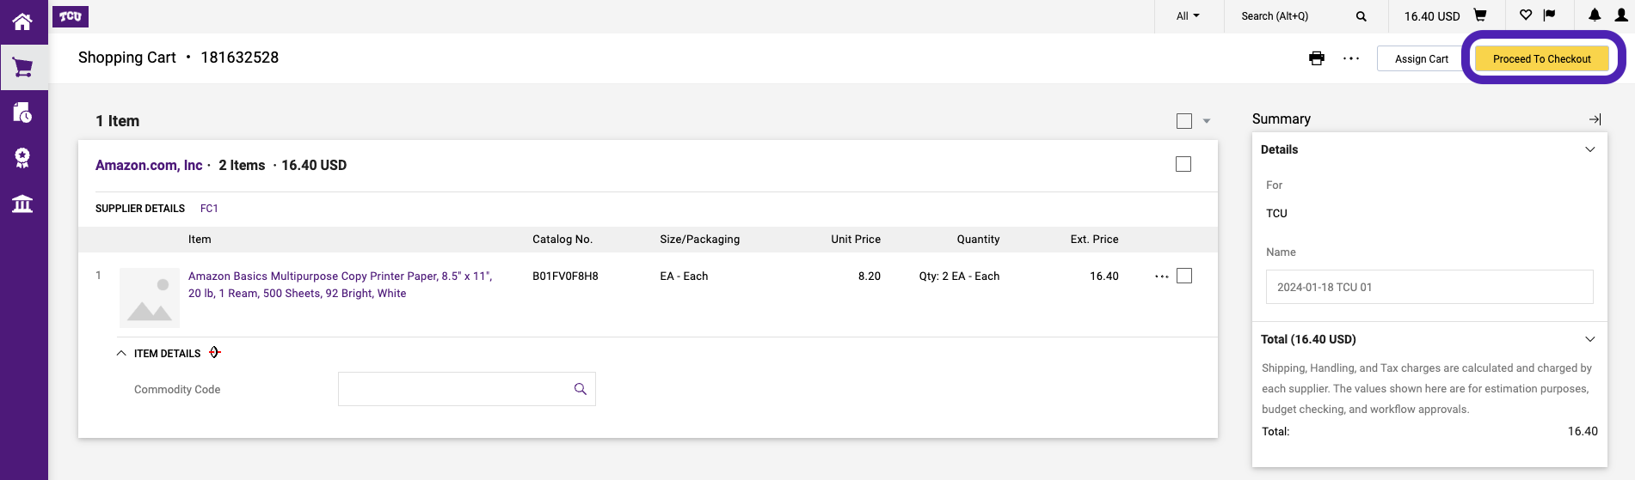
Step 6
Click “Proceed to Checkout”

Slide 15
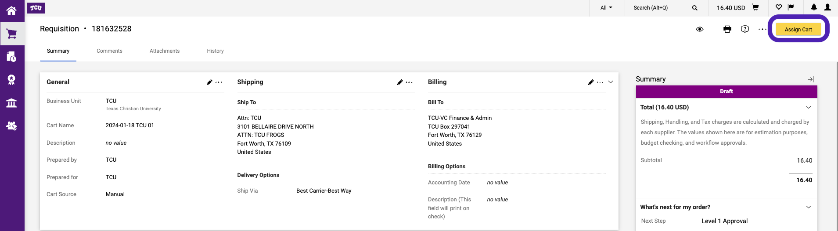
Step 7
If you are not a Requester meaning you are a Shopper or Approver, you will see and click on “Assign Cart”.

Slide 16
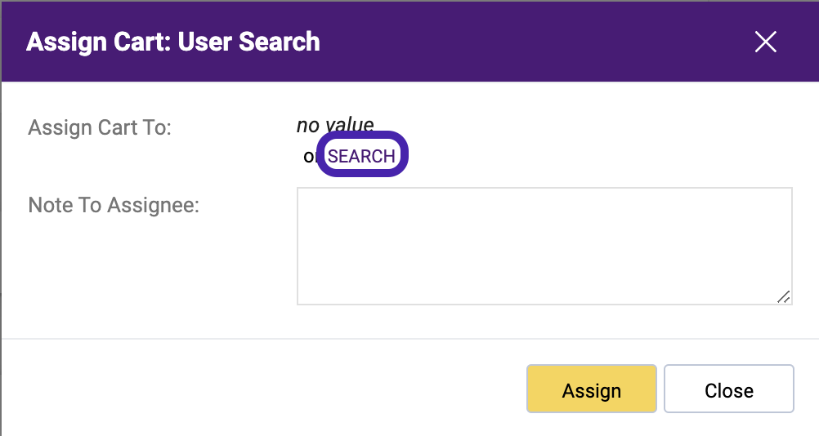
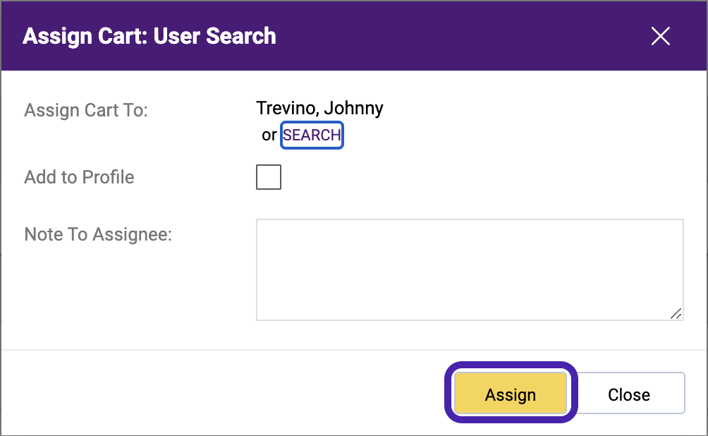
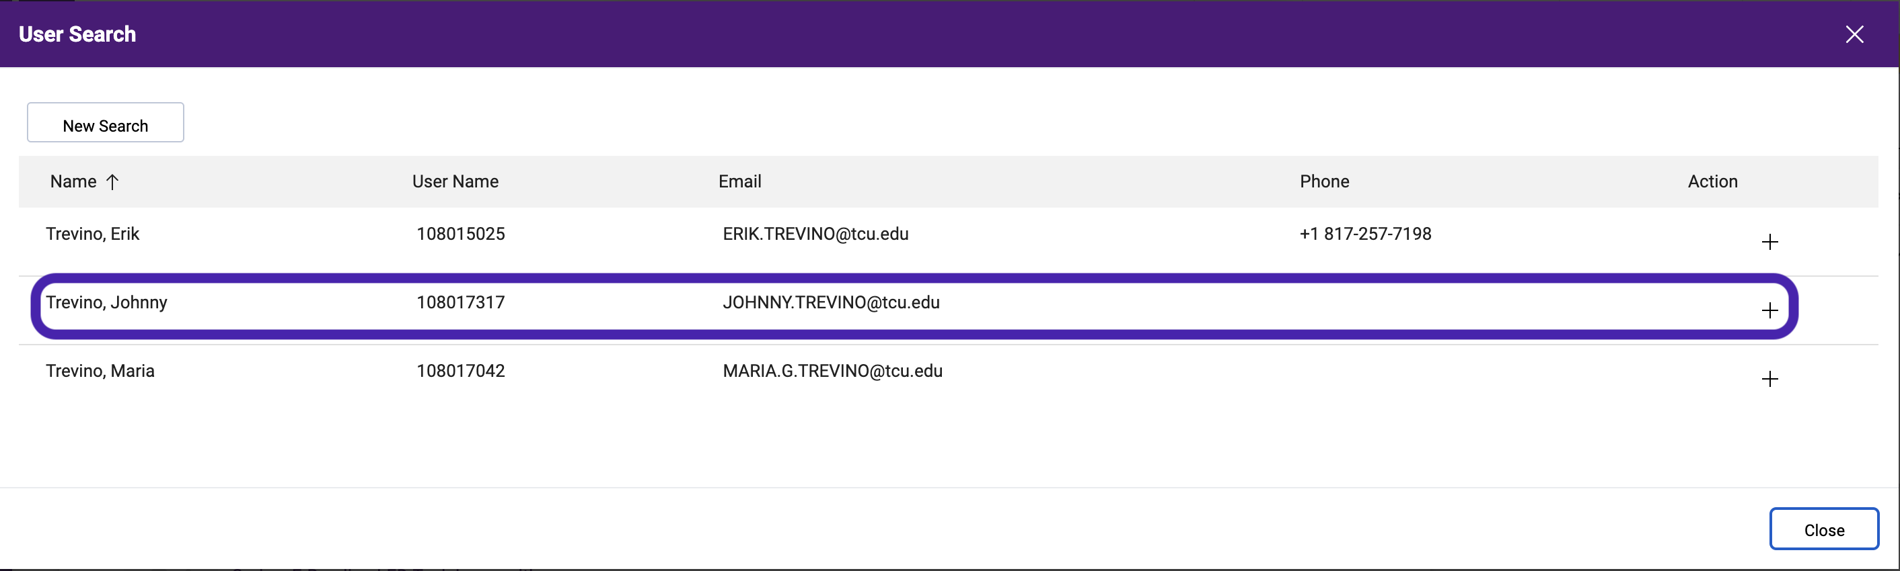
Step 7(a) for Non-Requesters
1: Search for the User
3: Select Assign to Finish
2: Identify the correct individual and select the + to Add

Slide 17
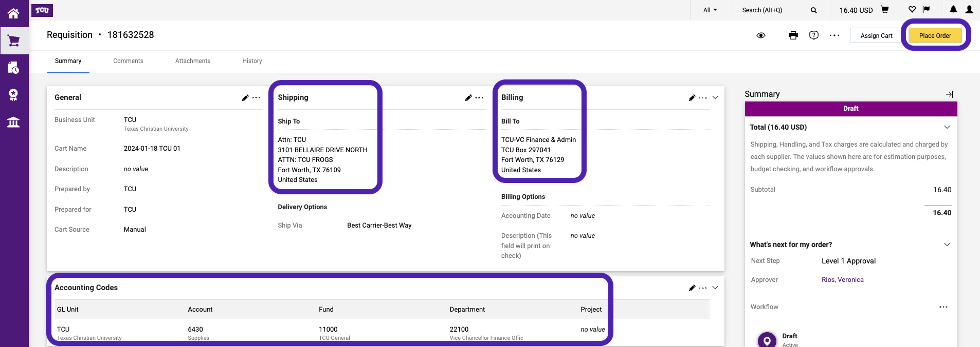
Step 8
Requesters will click on Place Order then verify 1. Shipping Address (Line 2 may be customized to be more specific (bldg., suite, and room number etc.) and 2. Accounting codes.
TIP: In the initial Jaggaer profile, set up the default address and accounting code which will populate automatically. You can then set up alternative address and accounting codes to save to Favorites.

Slide 18
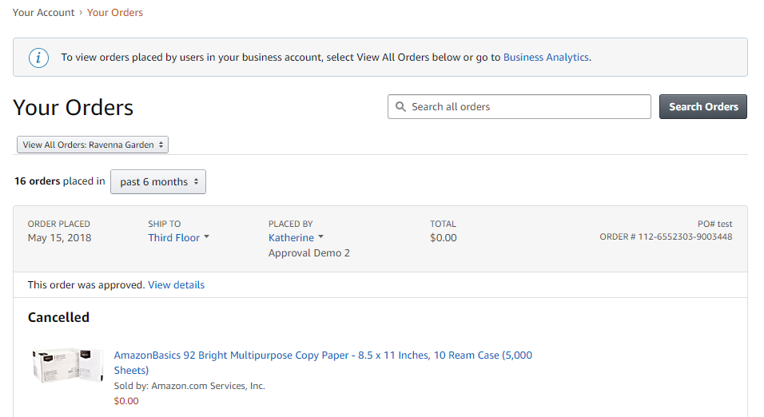
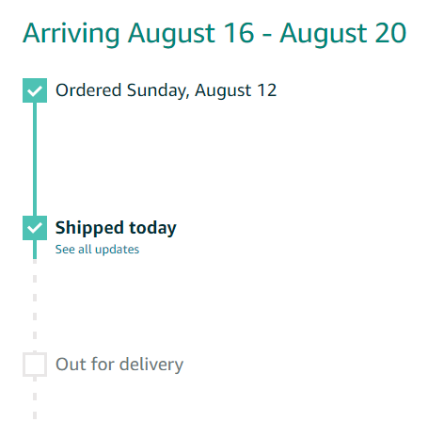
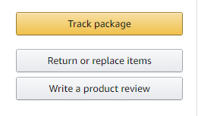
Your Orders - Returns
This section of the account provides additional detail regarding the status of all orders you have placed within the Business Account
Take a variety of actions on Your Orders:
Track Packages
Initiate a Return

Slide 19
NEXT STEPS
Individuals may need to request Jaggaer roles (Requester/Submitter or Approval). Request a Jaggaer role here: https://finance.tcu.edu/jaggaer-resources/access-request.php
Scenarios:
User has set up a personal account with a TCU email
  Option 1: Port this personal account to the TCU Amazon Business Prime account
  Option 2: Change the TCU email on the personal account with a non-TCU email account and start the new TCU account.
Individual User Business Account Admin
  Instructions will be given on transferring the business account if that account is set up with a TCU email.
Multi-User Business Account Admin
  Instruction will be given to migrate the account and all sub-users to TCU’s Amazon account
User has a personal Amazon account using a personal email
  Instructions will be given to the new TCU Amazon Business Prime account

Slide 21
Questions?
Jaggaer Training Materials:
https://finance.tcu.edu/jaggaer-resources/
Additional questions after training send to:
jaggaer@tcu.edu

