Slide 1
Jaggaer Contracts 101
Training for TCU
Back to Basics

Slide 2

TCU Contract Team Goals
Protect TCU’s students.
Protect TCU’s endowment and every other resource we have worked hard to acquire.
Protect TCU’s brand, reputation, and information.
TO PROTECT YOU

Slide 3
Table of Contents
Contract Process Overview
    Registering Your Supplier
    Submitting a Contract Request
      Contract Request vs. Contract File
    The Contract File Phase
      Finding the Contract Manager
      Uploading Documents
      Draft Stage
      Internal Review
      Pending Approval
      Out for Signature
      Downloading the Executed Contract
Navigating your Homepage
Master Agreements
  Signature Delegation Authority
  The Contract Administration Website

Slide 4
Contract Process Overview
Supplier Registration
Supplier completes Supplier Qualification Form (SQF)
Requestor submits the SQF and W9 or W8 to Jaggaer.
Contract Request
Requestor submits a Contract Request by uploading all applicable documents and providing required information.
See Contract Elements on the TCU Contract Administration webpage.
When the Contract Request is approved, the Contract Team will create a Contract File.
Contract File
Connect with your Contract Manager.
The Contract Team will review the documentation and determine other parties who need to review.
The Contract Team will submit for approval and signature.
Always Check the status of your contract!

Slide 5
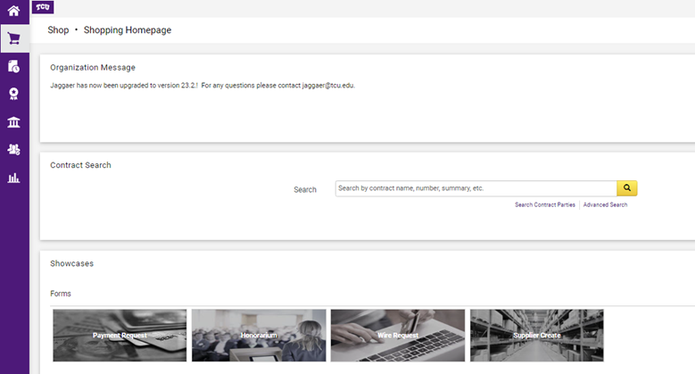

Registering Your Supplier
Registered suppliers are required to initiate a Contract Request.
To register a supplier, the requestor must ensure the supplier completes the Supplier Qualification Form (SQF), listed on the Accounts Payable Page under Forms.
Once the requestor obtains the SQF and the supplier’s W-8 or W-9, the requestor submits the documents to Jaggaer via the Supplier Create tile.
Allow the Accounts Payable (AP) team two - three business days to register the Supplier.
As soon as the email is received confirming the supplier has been registered, it’s time to create the contract request!

Slide 6

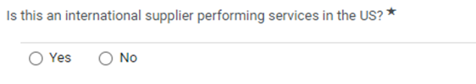
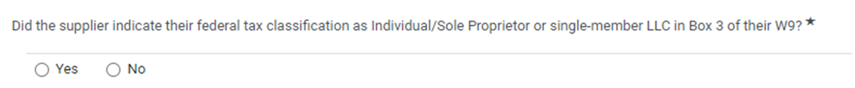
Helpful Tidbits from our AP Team
The International supplier question on the SQF should only be YES if the international supplier is performing in the US.
Pay close attention to the federal tax classification list in Box 3 of the supplier’s W9. It’s necessary for the supplier create form.
An Individual’s supplier registration will go to Human Resources for review. A Sole Proprietor will remain with AP for processing.

Slide 7
1st Rule of Thumb
vs
Jaggaer@tcu.edu
Contract_Questions@tcu.edu
This email leads to the AP group.
AP manages invoices.
AP manages suppliers.
If you need Invoice access in Jaggaer, request it from visit the Jaggaer System Access Request page.
AP cannot assist with contract statuses.
This email leads to the Contract team.
Contract Team manages contracts.
Contract access is not the same as Invoice access.
The Contract team cannot assist with invoice or supplier status.
Email Jaggaer@tcu.edu for invoice and supplier status only, they cannot assist with Contracts.

Slide 8

When to Request a Contract?
Does this agreement require a signature?
Is there a deposit or any pre-payment for services?
Will the supplier provide services on TCU’s campus?
Is this a click-through agreement?
Is there any alcohol involved?

Slide 9

Submitting a Contract Request
When creating your contract request, make sure the title is clear and complete.
  Excellent example: SCCD-Jamila Glass-10.2023
  Needs work: Parchment
  Absolutely not: Joy Tuider’s Contract
  Select the appropriate Contract Type. For type descriptions, click here.
  Remember software license agreements should be listed under Technology.
  Provide an informative summary & detailed information
  Paint a short story, what is the purpose of the contract?
  The detailed information you provide feeds directly into the contract for several of our templates and leads to shorter turnaround times.

Slide 10
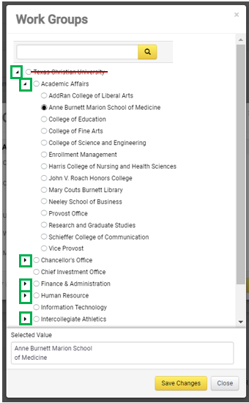
Selecting the Correct Work Group
Choosing the correct Work Group is important as it dictates the workflow, the approvers, and the signatory.
The Work Group is the group you work with at TCU.
Use the tiny black arrows and drill down to your specific Work Group.
Texas Christian University will never be your Work Group.
Academic Affairs will never be your Work Group.

Slide 11
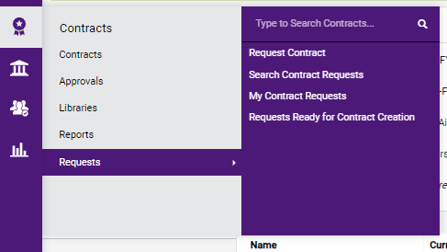
Finishing Off The Contract Request
Complete the rest of the information required to move forward.
Then upload the requested documentation. For a complete list of requested documentation see here.
  Once the request is submitted, the Contract Team will review it and, if approved, create the actual Contract File.
  You can review the status of your contract request by selecting My Contract Requests:
  NOTE: A Contract Request is not the same as a Contract File. To search your Contract Requests you must follow the above diagram.
Click here

Slide 12
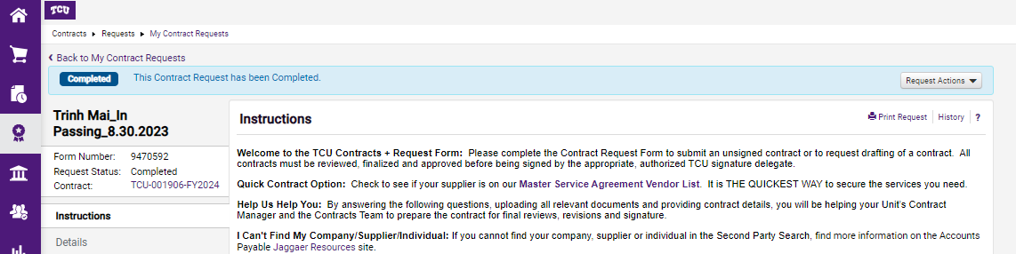
Differentiating between a Contract Request and the actual Contract File
Contract Request Number
Contract Number
CONTRACT
REQUEST
CONTRACT FILE

Slide 13

The Contract File Phase
During the Contract File Phase,
the contract is assigned to a Contract Manager.
If you have any questions about your contract, email the Contract Manager.
During this phase, the Contract Manager and other departments will review your documents.
  Once the terms have been negotiated and approved, the Contract Manager will send your contract for signature.
  Make sure to keep up with the status of your contract.

Slide 14
2nd Rule of Thumb
  If you have a question and there is no contract, email Contract_Questions@tcu.edu.
  Ex: I’m about to request a speaker contract, do I need a COI?
  If you have a question about a specific contract or amendment, email the Contract Manager.
  Ex: The supplier for contract 001908 sent new terms, I don’t agree with them. What should I do?
  If you have a question about the status of your contract, as responsible contract requestor, you can find that information yourself and we’ll show you how!
  Ex: What is the status of contract 001908?

Slide 15

Contract Party Information
Department Contact vs. Second Party Contact & Second Party Signatory
The Department Contact is the TCU contact/representative [the person with knowledge about the goods or services].
The Second Party Contact is the person from the Supplier to work with and decide on any terms. They will be contacted with questions.
The Second Party Signatory is the person on the Supplier side who will sign the contract on behalf of the Supplier.
The Second Party Contact & Second Party Signatory can be the same person.

Slide 16
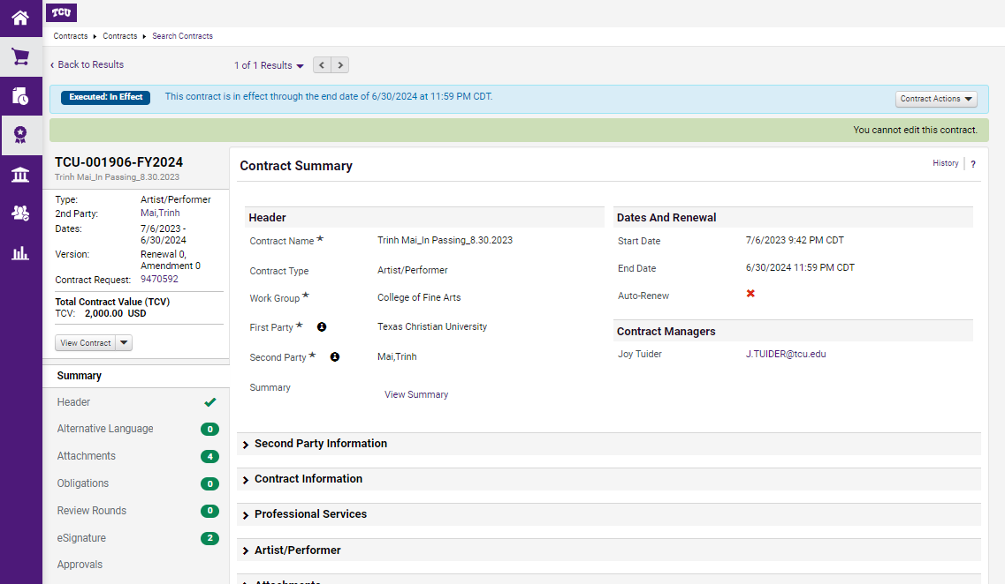
Finding the Contract Manager
Remember the 2nd Rule of Thumb.
Is the question specific to a contract?
If so:
Go into the contract and review the left side panel.
Select Summary then check out who your Contract Manager is.
1st Click here

Slide 17

Draft Stage
The DRAFT STAGE means the contract is in the Manager Contract queue.
While in the Contract Manager queue there are several things that could be happening:
  The contract manager is reviewing the documentation and there are discussions
  The contract is pending additional information/documentation
  The contract manager has just received the contract (from a contract request or from internal review) and it is pending review.
  The contract manager is actively working on the contract.
  Always check the Communication Center and the Comments section to see if there is any additional information.

Slide 18
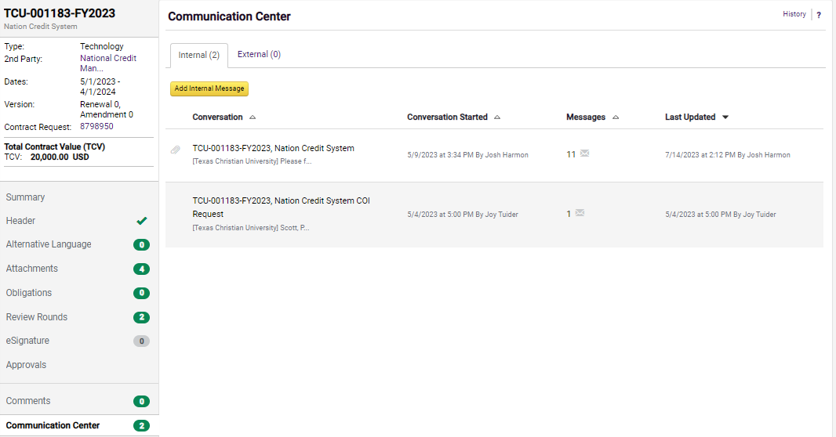
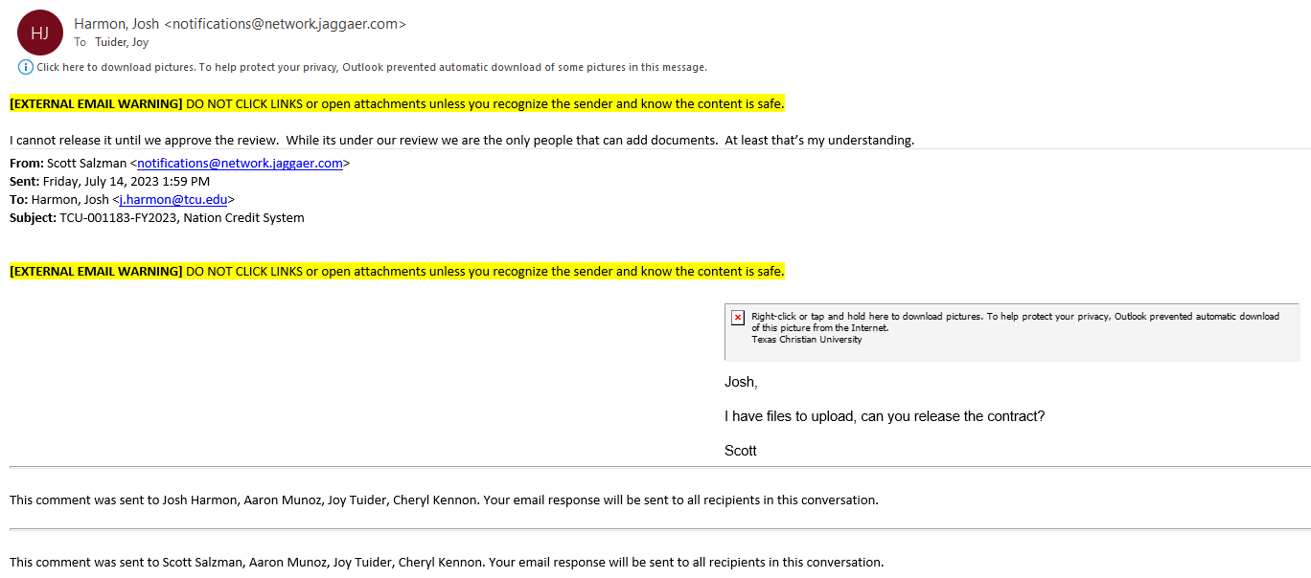
The Communication Center
The Communication Center is a helpful tool that allows you to review previous correspondence and send emails directly from the contract.
If you send an email from the Communication Center, it will be stored in the system and the receiving parties will receive a copy in their email.
They can either respond in the system OR they can respond from their email address.
NOTE: If you respond from your email address the correspondence will be sent to all those who are subscribed to the email and it will be stored in Jaggaer.
Click here 2nd
Click here 1st

Slide 19
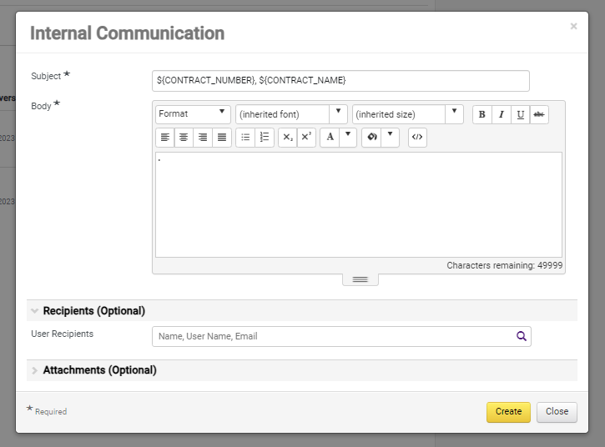
Effectively using the Communication Center
Always ensure your email is going to someone! Include all of your desired recipients.
Make sure to keep the information already in the subject line, it will add the contract number and name automatically.
You can add additional wording in the subject line.
You can add any attachments you would like here. If you add it here, it can quickly be added to the contract.

Slide 20

Uploading Documents
The Contract Manager has requested a COI and there is updated documentation.
What now?
Respond to the email that was sent to you requesting the documentation. Your email response and the attachment will be stored in the Communication Center.
Another option is to send an email from the Communication Center, as shown previously.
The Contract Manager will be able to upload it to the contract file from there.

Slide 21

Internal Review
During the Internal Review phase, the Contract Manager and other departments are reviewing the uploaded documents.
  IT reviews all technology contracts
  Marketing will review all contracts dealing with advertisements, name, logo usage especially over $5k.
  The Registrar office will review all FERPA concerns
  Risk will review all certificates of insurance
  Others will review as required.
Once the Internal Review is complete, the contract returns to Draft Stage.

Slide 22
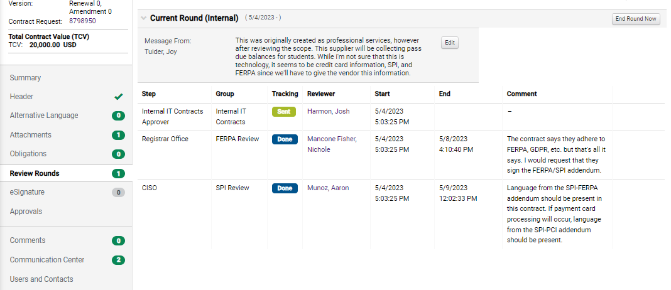

Internal Review
Always check the Review Rounds section to see who is assigned a round and what comments have been made.
Select the Review Rounds tab and review all notes.

Slide 23
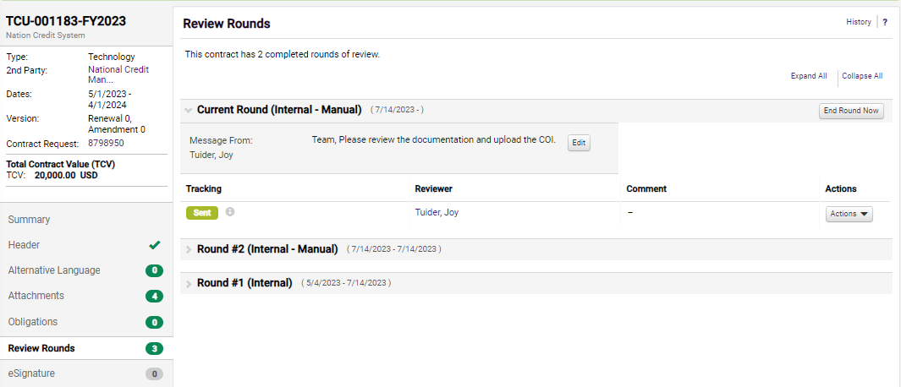
What if I have an Internal Review?
Go to Review Rounds and read what is requested of you in the message box.
Once you have completed the request and uploaded the document (as applicable), select the Actions drop down and click Done With My Review.
Make sure to leave a note responding to the request in the message box.
Contract Manager

Slide 24

Pending Approval
Once the necessary reviews are completed and the documentation is finalized, the Contract Manager will submit the Contract File for review and approval.
The Contracts Director, Senior Assistant Vice Chancellor for Finance, Business Officer(s), and other reviewers as applicable will review and approve the contract.

Slide 25
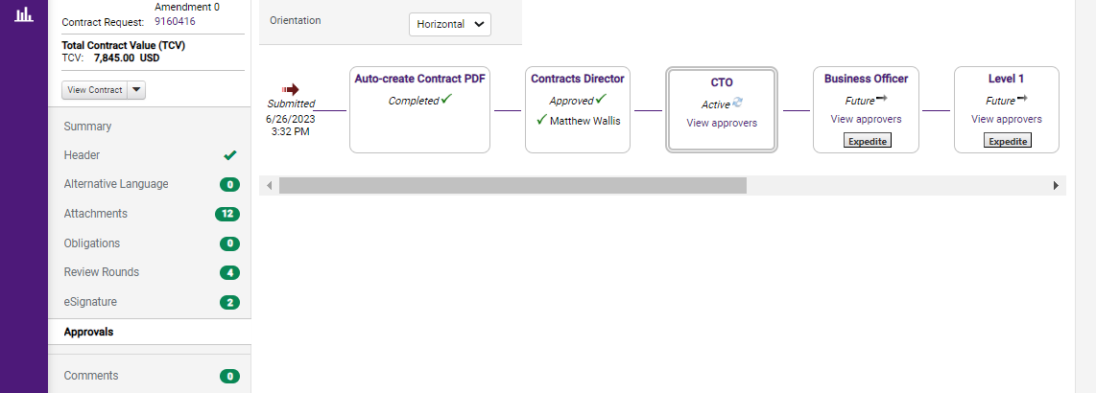
Pending Approval
Always check the Approvals tab to see pending approvals.
If there is a check beside the name, that person has approved the Contract File.
Select View Approvers to determine who may need a gentle reminder.
Click Here

Slide 26

Out for Signature
We're almost there!
The contract has been approved, but now we need signatures to make this dream a reality.
As a contracting team of 4 with over 250 contracts per month, we need your help.
Because you are a responsible Contract Requestor, we know you have been watching the status of your contract. You see the contract is OUT FOR SIGNATURE. Please email your Supplier and request that they review and sign the contract!

Slide 27
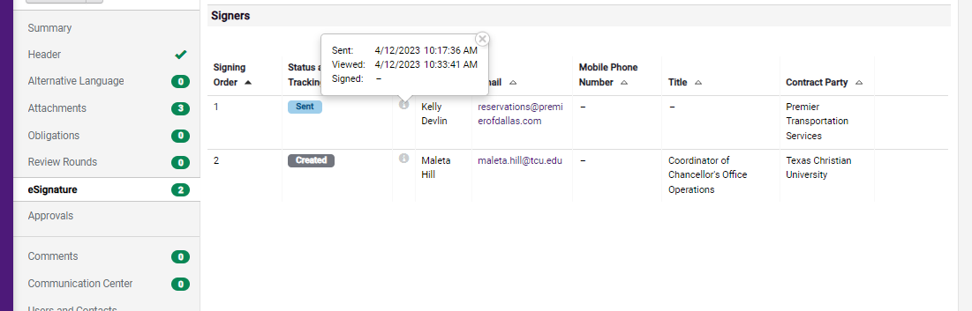

Out for Signature
Always check the eSignature tab, when your contract says Out for Signature.
Select the small i (for information) to see when the contract was sent to the Supplier, if and when the Supplier viewed it, and when it was signed.
You can do the same for the TCU Signatory.
Select here

Slide 28
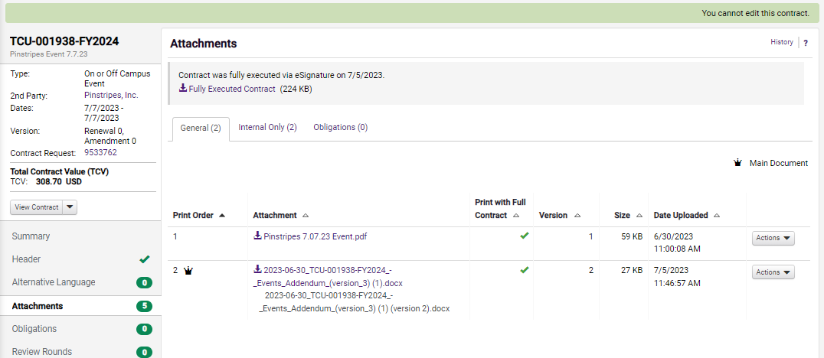


Executed
You are done! Great Job!
The contract has been signed and it is ready for use.
Go into the Attachments tab and select Fully Executed Contract to download the signed agreement.
Click here to download the executed contract

Slide 29
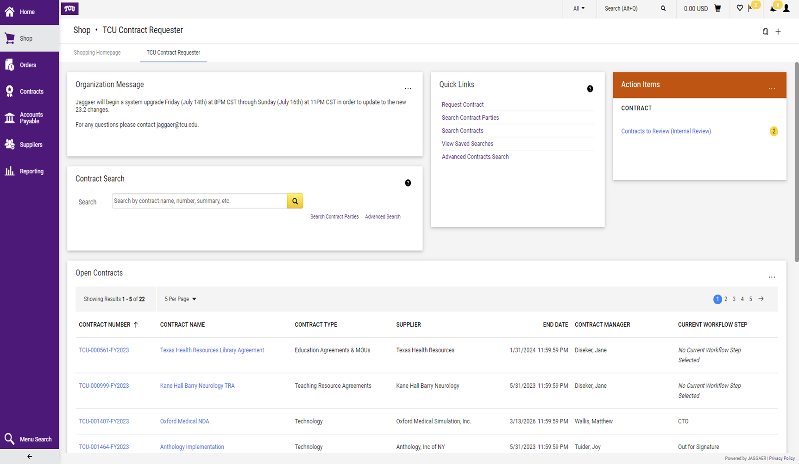
Navigating your Home Page
View Notifications
Click here for the Shopping Home page
View Action Items
Open Contracts at a Glance
Search for your contracts here

Slide 30
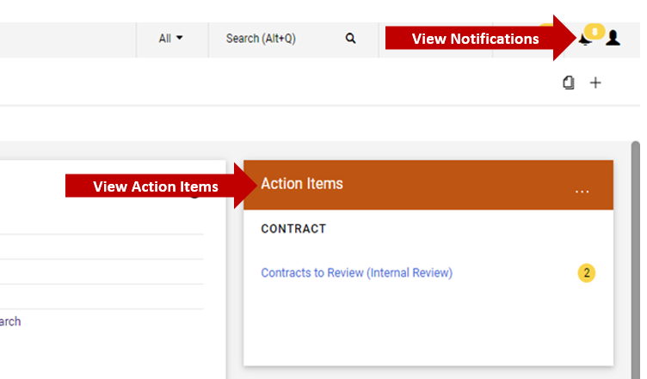
Viewing Notifications & Action Items
Whenever there is any movement on your contract and contract request or there is an action requested of you, it will appear in your Notifications at the top right.
Always review your Action Items to determine what is needed from you to move your Contract File or Contract Request forward.

Slide 31
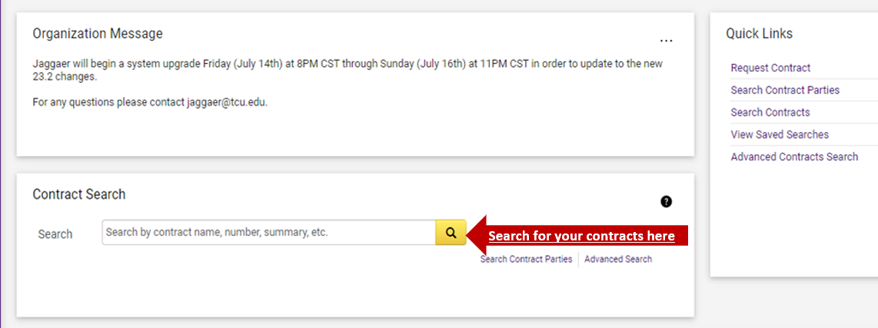
Searching for Contracts
When searching for a Contract File (not a Contract Request), use the Contract File number, supplier, or title.
If the contract number is TCU-001908-FY2024, you can search for the Contract File by using 001908.
  If you search by only the last four digits (1908) Jaggaer will not be able to find the contract.
  NOTE: If searching for a contract request, you must search by going to the Contracts Request page.

Slide 32
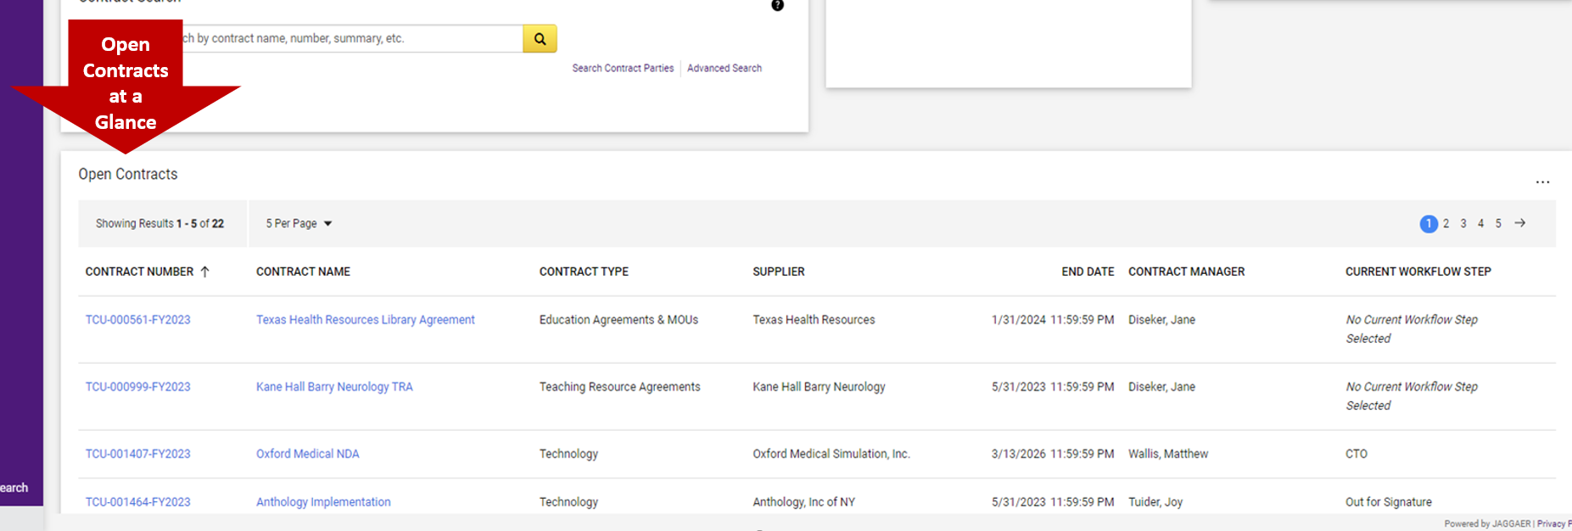
Open Contracts at a Glance
This is a list of your open contracts.
Here, you can view the Contract File number, name, Contract Manager, and workflow status.
This is a great place to review the statuses of all of your contracts in a matter of seconds!
NOTE: If says No Current Workflow Step Selected, it is in an Internal Review.

Slide 33
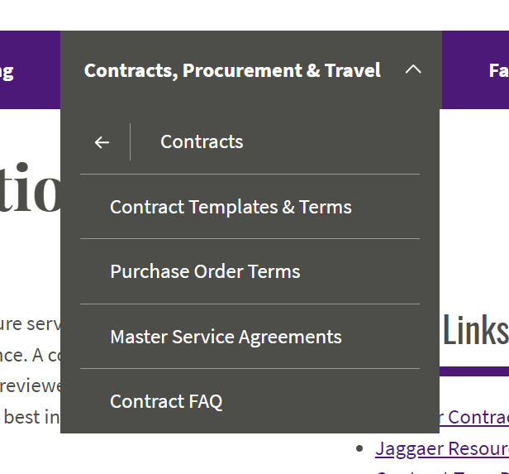
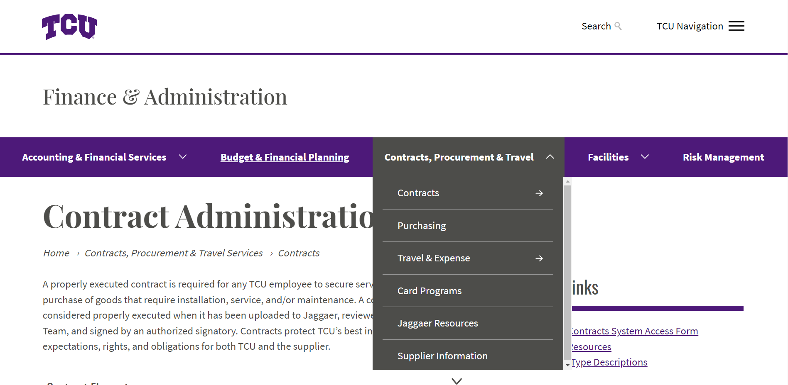
Who wants a quicker way to get a contract executed?
Check out the TCU Suppliers who have Master Service Agreements!

Slide 34
Signature Delegation Authority
Jaggaer will route contracts to the appropriate designated signatory.
Only employees who have signature delegation authority are permitted to sign contracts on behalf of TCU.
Employees who do not have authority and still sign the contract may be personally liable for payments and/or risks.
Please review TCU’s SDA policy.
To be safe, allow Jaggaer to route contracts to the correct signatory. Do not sign prior to uploading to Jaggaer.

Slide 35
The Contract Administration Website
This website was designed to quickly guide you through the contract process in three easy steps.
The website contains information on required documentation, types of contracts, and examples of templates.

Slide 36
Thank you
Photos in this presentation by Unknown author are licensed under CC BY-SA.

