Slide 1

Jaggaer Training
Back to Basics
Spring 2026

Slide 2

Introduction
The Jaggaer Solution was implemented to streamline and introduce transparency to TCU’s Contract process.
The Contract team’s goal is to ensure our users get the most out of Jaggaer with trainings and guides.

Slide 3




Meet
Our Team
Matthew Wallis
Contract Administration Director
Jane Diseker
Assistant Director, Contract Administration
Joy Tuider
Assistant Director, Contract Operations
Juanette McCollum
Contracts Paralegal

Slide 4

Our Purpose
We strive to protect TCU.
Mission
Vision
To support the University’s mission by contracting services on behalf of the students, faculty, staff, and alumni with as little risk to TCU as possible.
We embrace forward-thinking processes and innovative solutions to help ensure that the University is at the forefront of higher education with contracts administration.

Slide 5
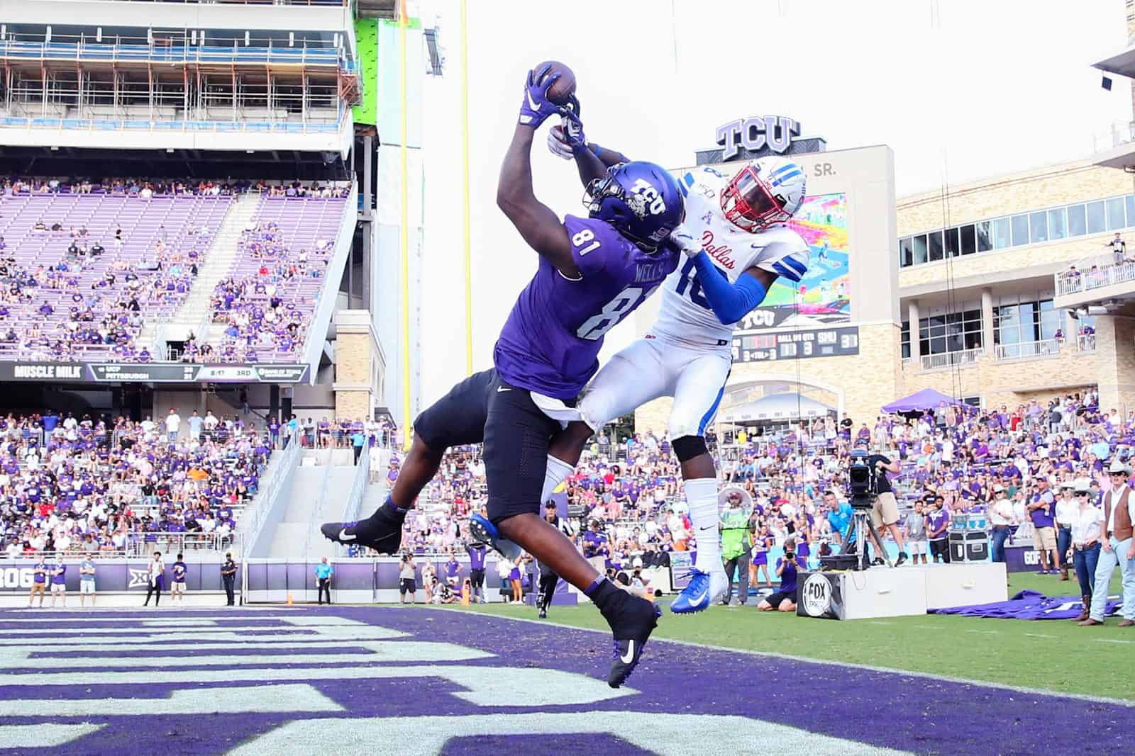


...WITH AS LITTLE RISK TO TCU
AS POSSIBLE!
Contracts Team
Supplier
Our job is to make sure you make your purchase with as little liability TO TCU as possible.
Their job is to make a profit and sell you their product with as little liability TO THEM as possible.

Slide 6
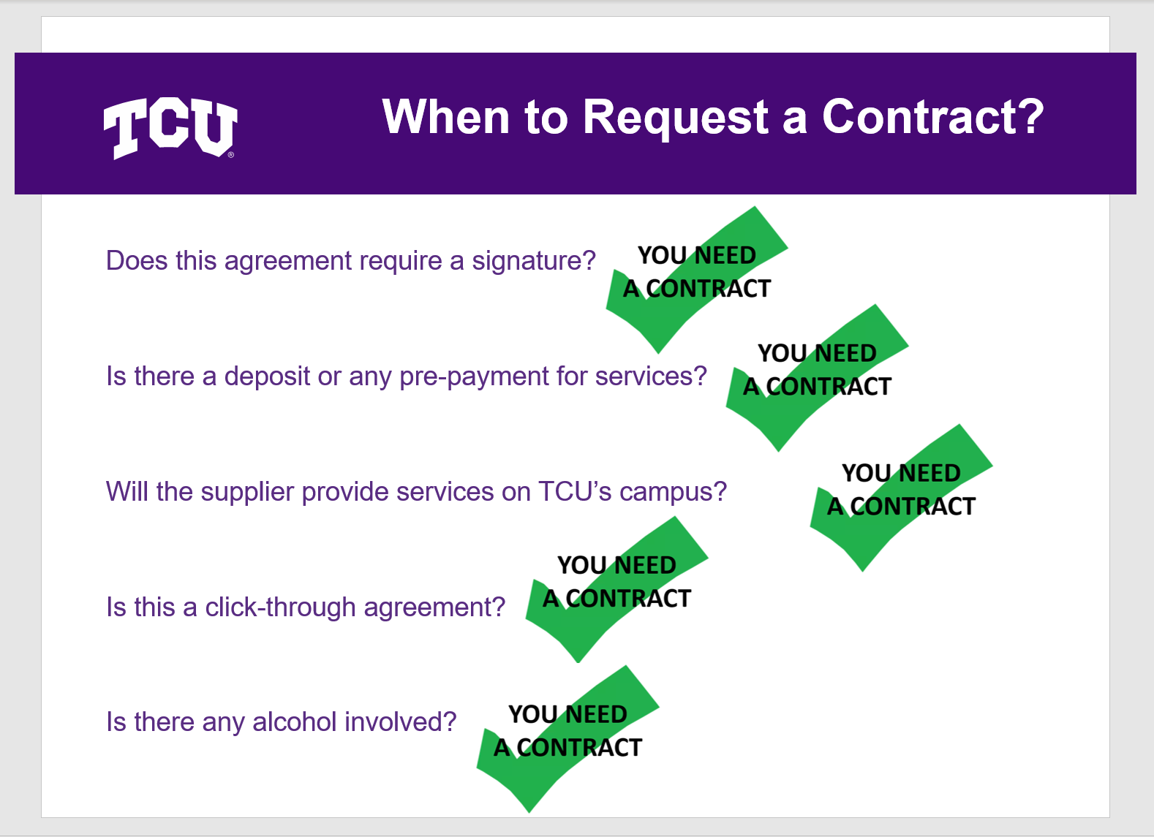
When do we need
a Contract?

Slide 7



step
1.
DETERMINE THE COST

Slide 8
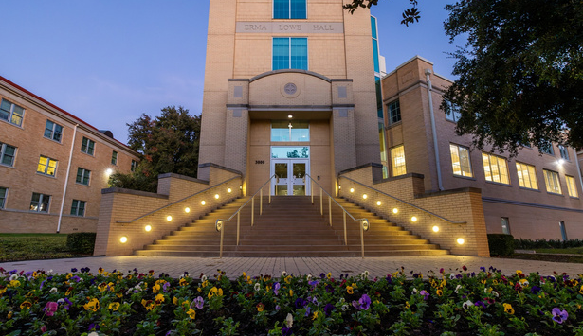



step
1.
PROCUREMENT THRESHOLDS
To ensure TCU receives the greatest value for its spend, the Procurement Team has established cost thresholds for contracts. For any exceptions to this policy, please refer to the Procurement Policy.
$1 - $49,999
$50,000 - $249,999
$250,000 AND OVER
Submit supplier request or contract request per usual.
Department must obtain at least two (2) quotes. Then submit supplier request or contract request per usual.
Department works with Procurement to complete a formal solicitation/bid process. Then submit supplier request or contract request.
good to go!
email procurement!
depends!

Slide 9
step
2.
SUPPLIER
REGISTRATION

Slide 10



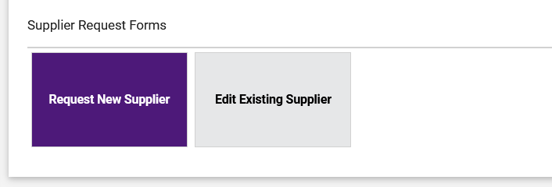
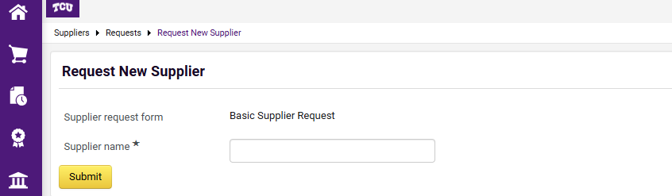
step
2.
THE SUPPLIER PORTAL
The newly designed Supplier Portal allows departments to quickly submit their desired vendor into the system.
Once the correct name, email address, and Tax ID# have been entered, the system sends a link to the vendor so they can complete and upload their own information.

Slide 11
step
THE CONTRACT REQUEST PHASE
3.
important!

Slide 12
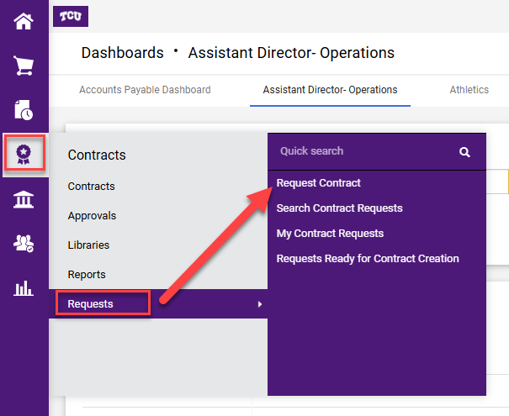
Start the request

Slide 13
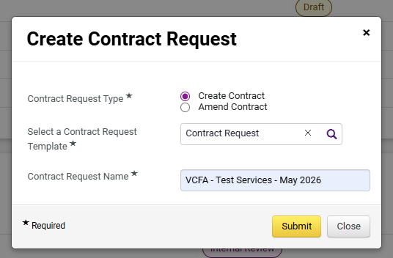

Slide 14

Naming
Convention
Workgroup
Same vendors with different workgroups. Approval workflows.
Service Name
What are you buying?
Date service takes place
What is the anticipated start date?

Slide 15
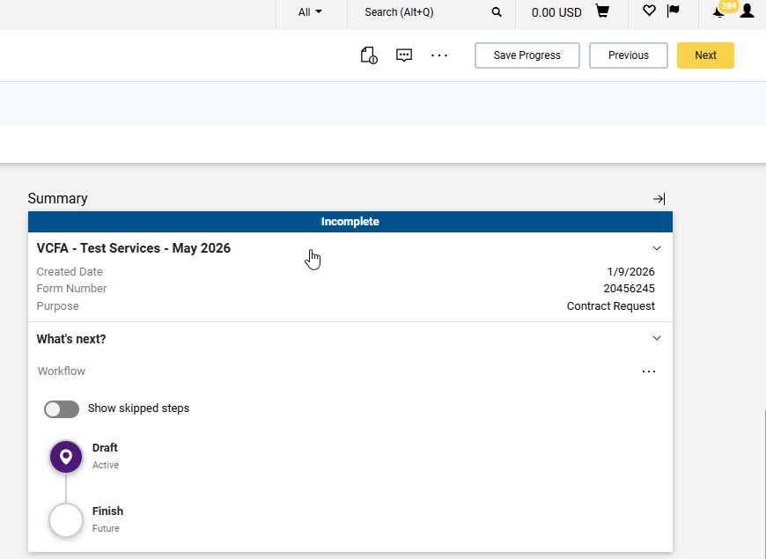

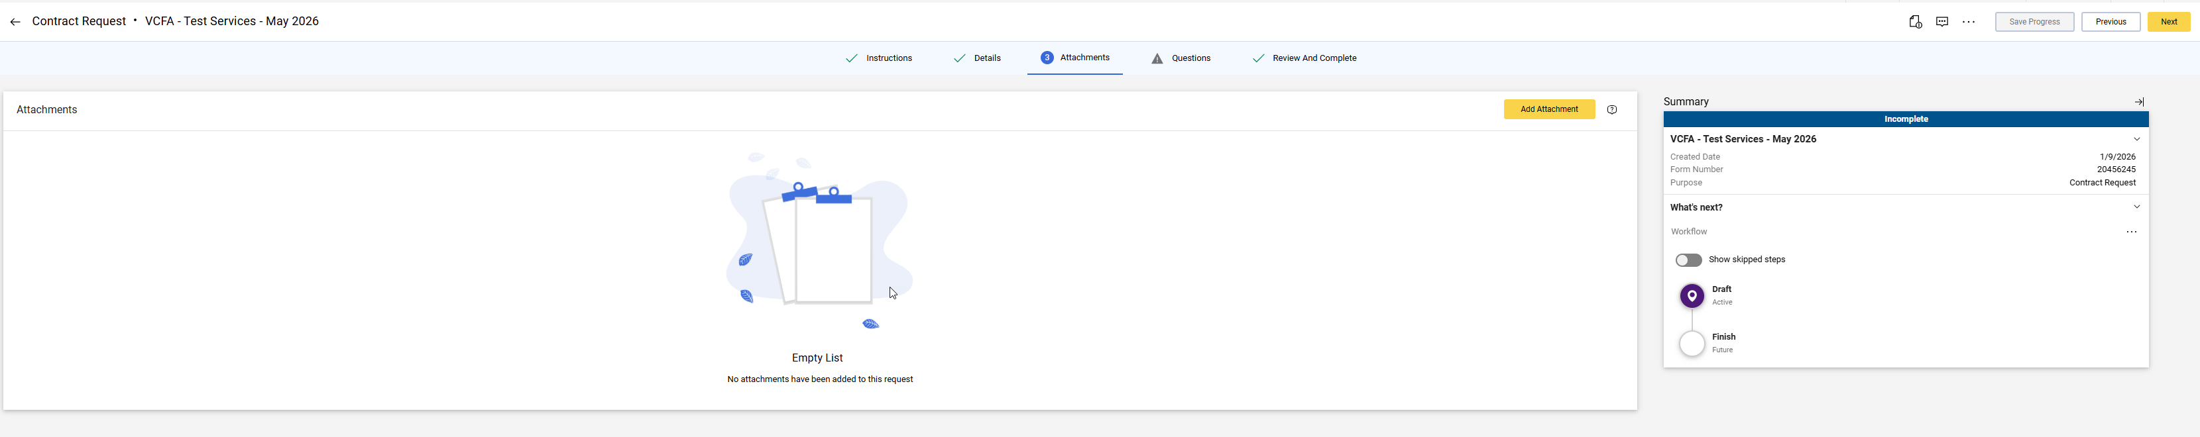
Always click Next.
2.
1.
Contract Elements
Quotes/Pricing
Quantity (if applicable)
Scope of Work/Proposal/Detailed Description of Services
Dates of Service
Certificate of Insurance (if there is no Master Service Agreement)

Slide 16
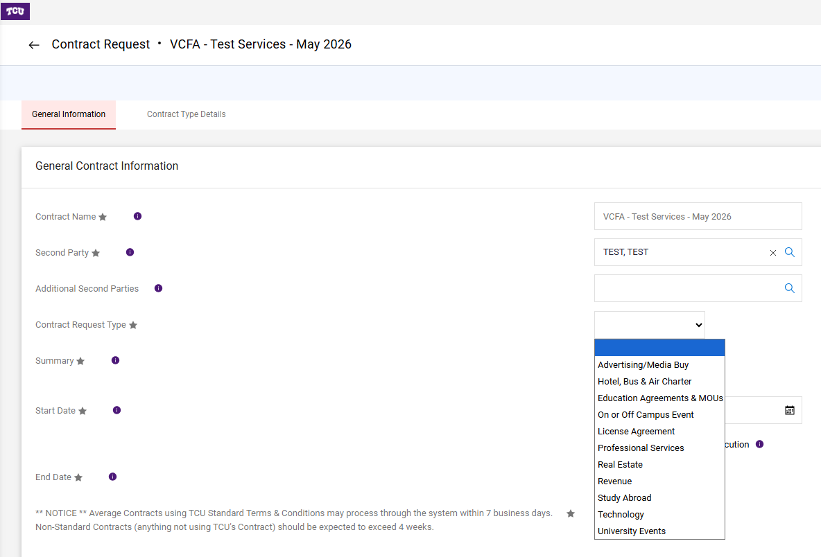

Slide 17
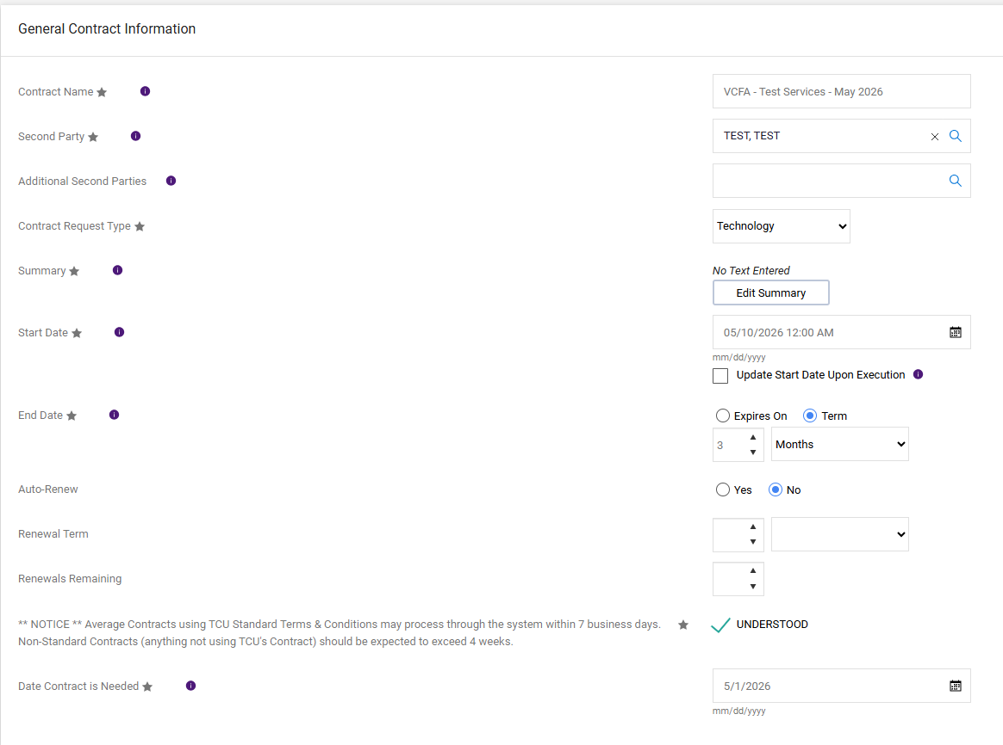


Slide 18
Informative Summary
The Contracts Administration Team and the Subject Matter Experts need to know the purpose of the contract.
Tells the Contract Manager:
WHO is using/doing WHAT and HOW.
Restates and information already provided like the title, type of service, dates
Examples:
“45 licenses and support”
“see T&C’s”
“License and support plan. One Year term”

Slide 19


Slide 20
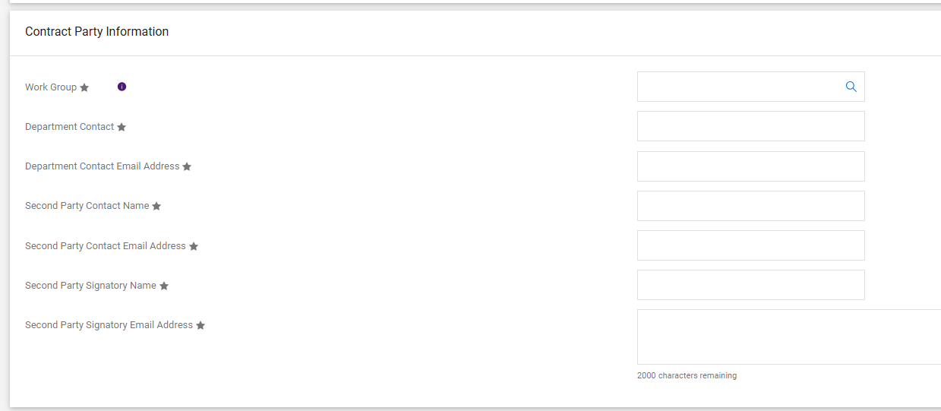

Slide 21

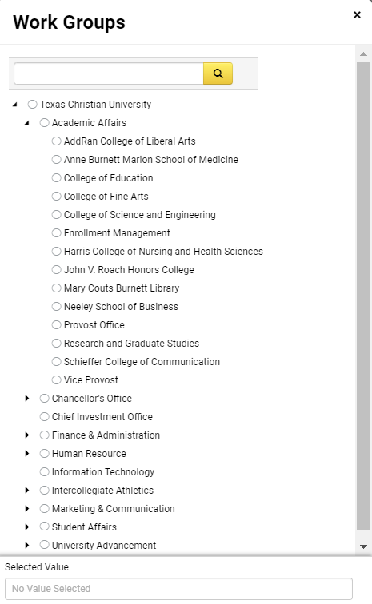
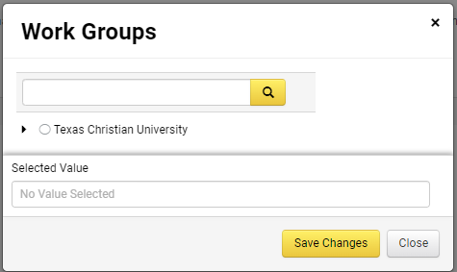

Select the Correct Work Group
Use the tiny black arrows to drop down to your specific work group.
Work group determines workflow.

Slide 22


Slide 23




Contract
REQUESTOR
Contact
DEPARTMENT
Contact Party Information
Second Party
SIGNATORY
Second Party
CONTACT

Slide 24
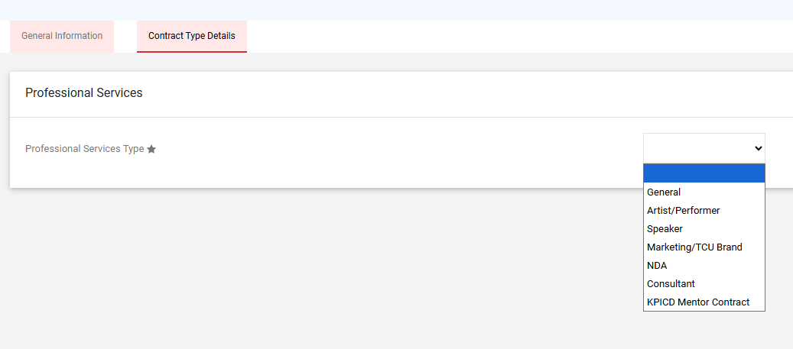
Once you complete, the general information tab, select Next.
It will take you to the second tab under “Questions” to complete additional information.

Slide 25
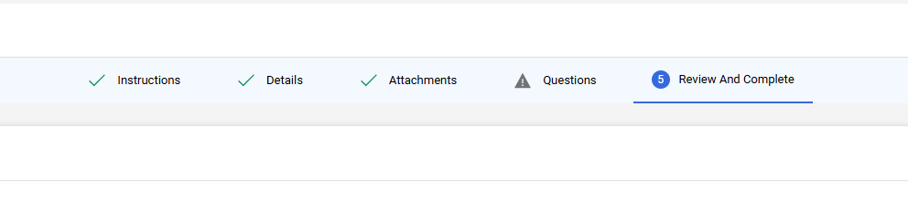
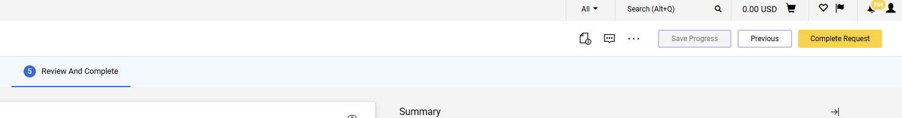
Click Next.
If there is any hazard sign, something is incomplete.
When tabs 1 - 4 have green arrows, click #5 Review and Complete and select Complete Request.

Slide 26

Descriptive Title & Detailed Summary | Correct Workgroup
Completed Scope of Work | Terms & Conditions
Confirmed Dates of Service | Correct Contract Type
Verified Contact Information | Certificate of Insurance
Request Checklist

Slide 27
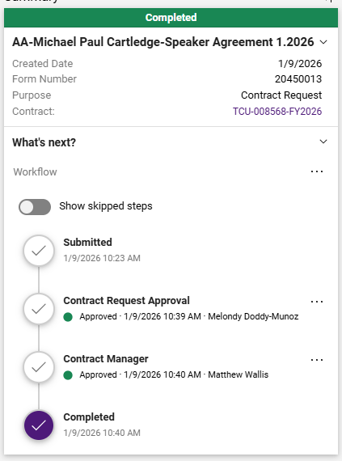
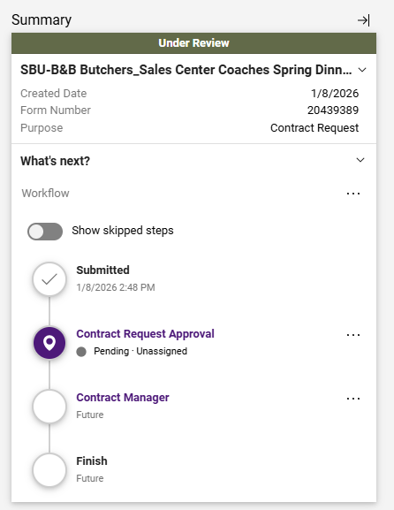
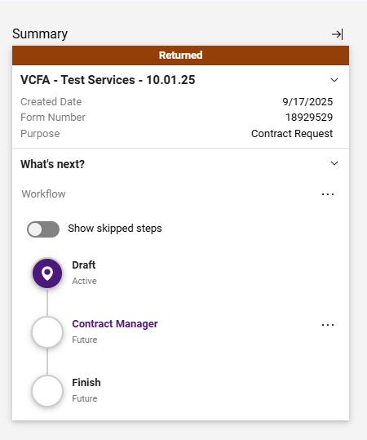

CONTRACT REQUEST
TCU-00XXXX-FY2026

Slide 28

step
MONITOR THE CONTRACT FILE
4.
TCU-00XXXX-FY2026

Slide 29




CONTRACT
STAGES
Internal Review
Out For Signature
Check the Review Rounds and contact whoever doesn’t have “Done” by their name.
Check the eSignature tab and contact whoever has “Sent” by their name.
Pending Approval
Draft
Check the Approvals tab and contact whoever populates when you select View Approvers.
Contact the Contract Manager.

Slide 30
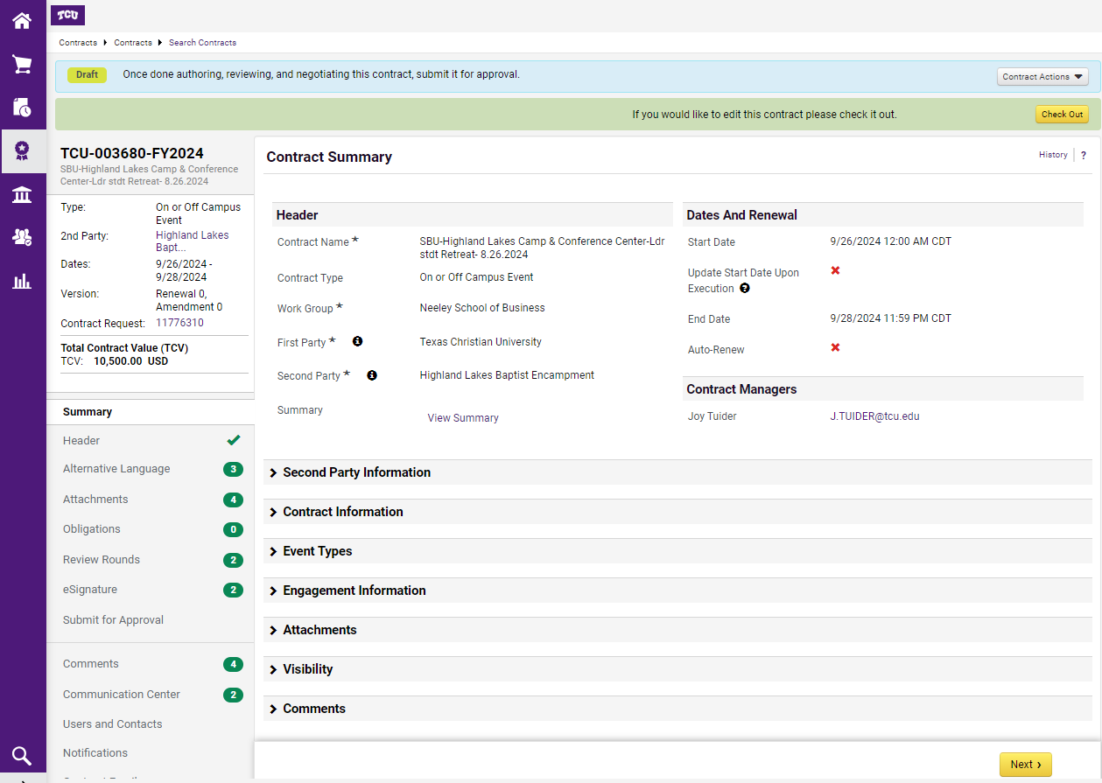


Monitoring the Contract File
Monitor the Contract File as it moves through each of the phases.
Contact the Contract Manager with any questions for your specific contract.

Slide 31



CONTRACT
STAGES
Out For Signature
Internal Review
Check the eSignature tab and contact whoever has “Sent” by their name.
Check the Review Rounds and contact whoever doesn’t have “Done” by their name.
Pending Approval
Draft
Check the Approvals tab and contact whoever populates when you select View Approvers.
Contact the Contract Manager.

Slide 32
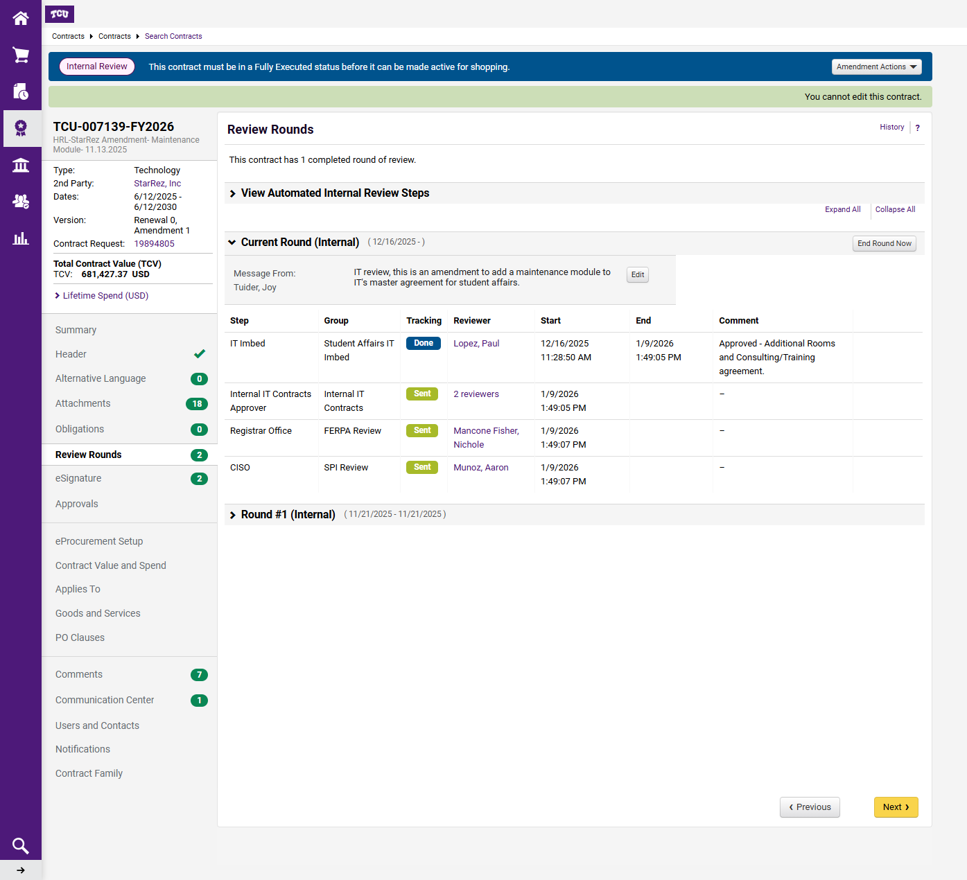
Internal Review
Email Reviewers with green “sent” boxes

Slide 33
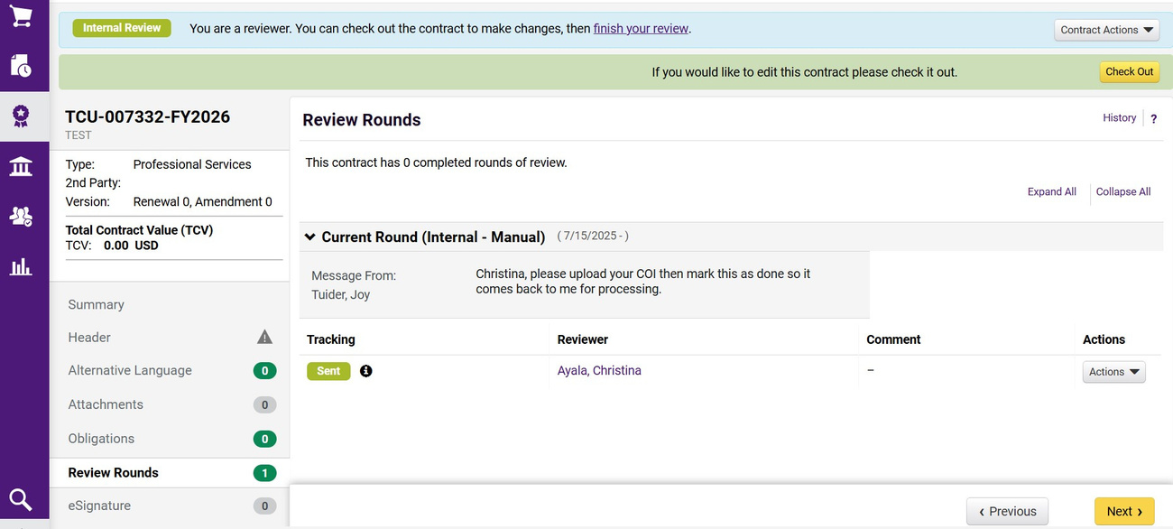

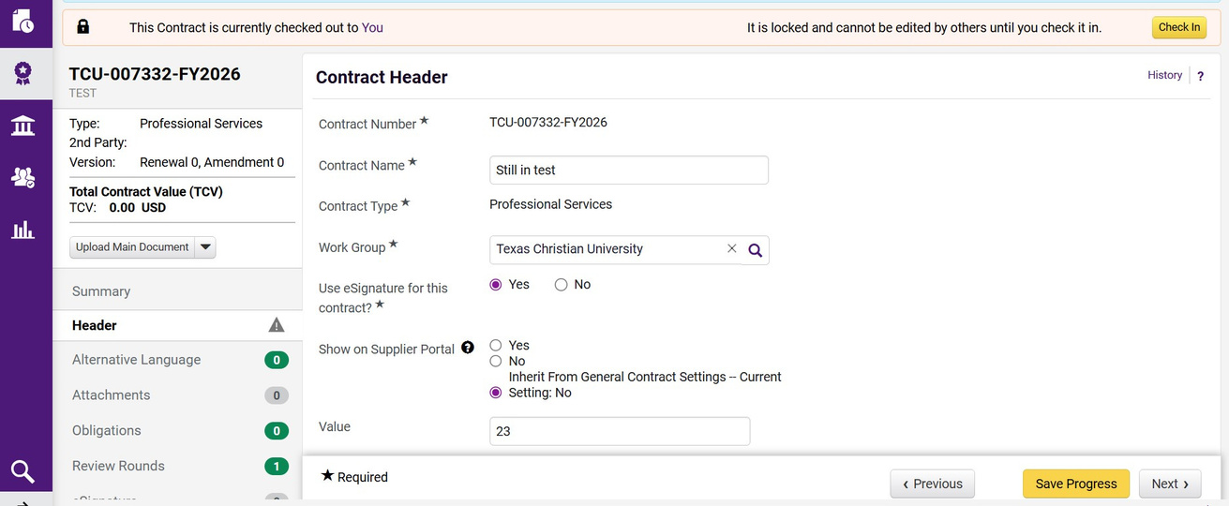
What if I have an Internal Review
Check out your contract and make whatever changes you need.

Slide 34
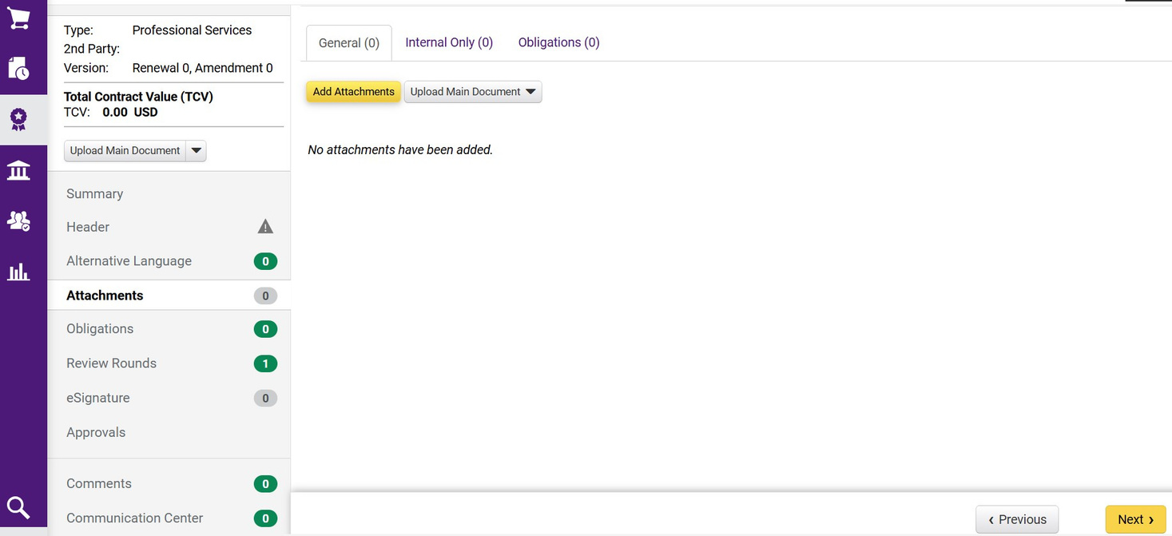
What if I have an Internal Review
Check out your contract and make whatever changes you need.

Slide 35







...A BIT MORE ABOUT
attachments
General Attachments
Full Contract OR
Fully Executed Contract
Internal Only
The Full Contract is generated from the documents in General Attachments.
This is what Contract Approvers should review as it will be sent to the vendor for signature.
Once it’s executed, it becomes a Fully Executed Contract document.
refer to pg. 33
These documents will not be sent to the vendor and are only references for the file.
These documents are populated by the Header and can be edited to send to the vendor.
These documents make up the Full Contract.

Slide 36
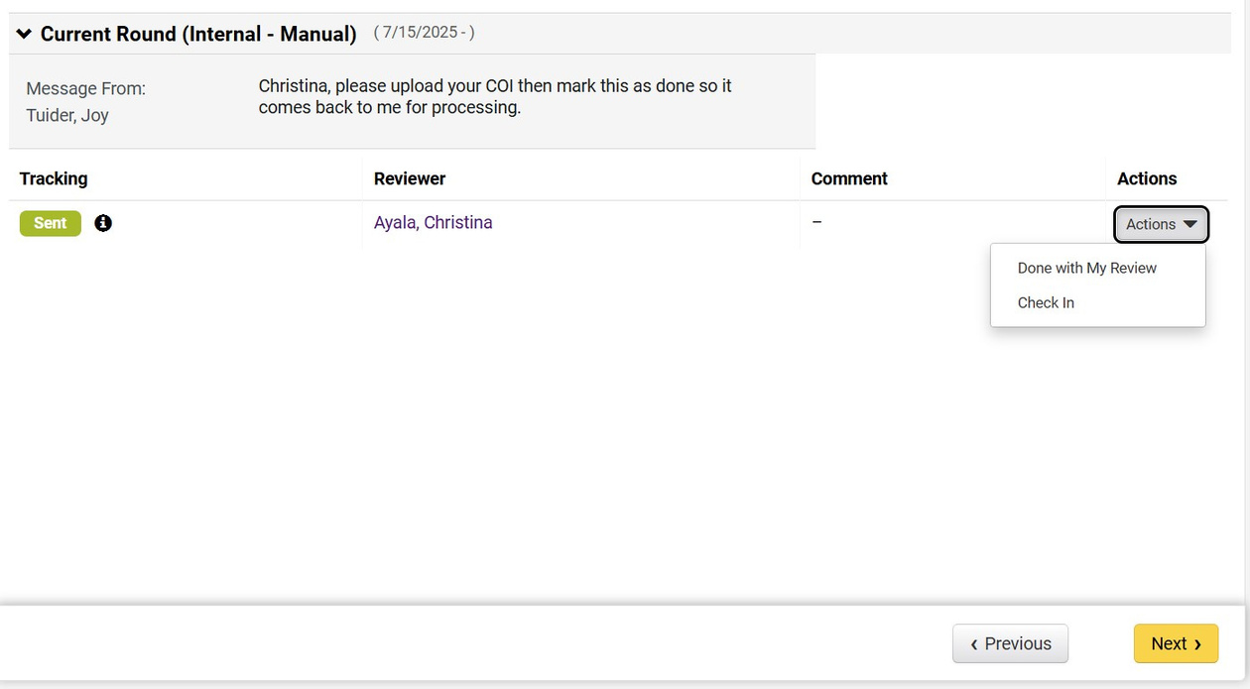
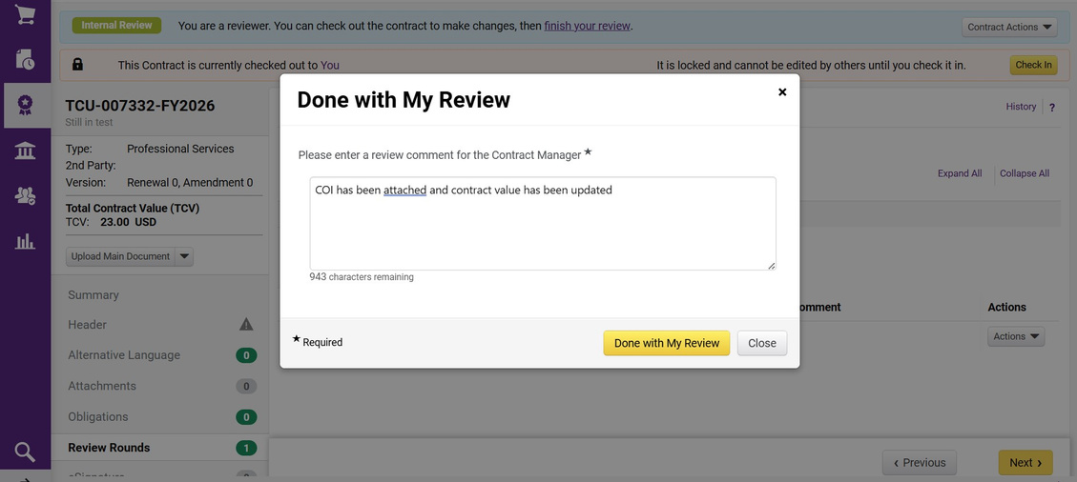
Complete your Internal Review
Check your contract back in.
Mark your review round as done.
Confirm what you have changed, uploaded, or provide any information you received.

Slide 37


CONTRACT
STAGES
Internal Review
Out For Signature
Check the Review Rounds and contact whoever doesn’t have “Done” by their name.
Check the eSignature tab and contact whoever has “Sent” by their name.
Pending Approval
Draft
Check the Approvals tab and contact whoever populates when you select View Approvers.
Contact the Contract Manager.

Slide 38
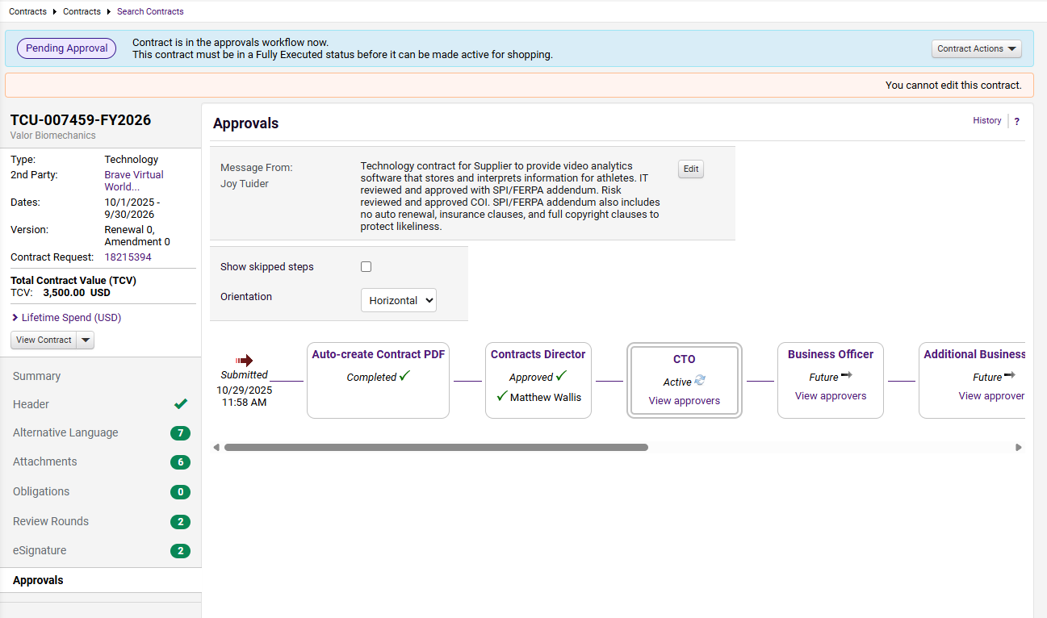
Pending Approval
Send reminders to reviewers who need to approve the contract.
The green check means they’ve already approved the contract.
Click on View Approvers.

Slide 39

CONTRACT
STAGES
Internal Review
Check the Review Rounds and contact whoever doesn’t have “Done” by their name.
Out For Signature
Check the eSignature tab and contact whoever has “Sent” by their name.
Pending Approval
Draft
Check the Approvals tab and contact whoever populates when you select View Approvers.
Contact the Contract Manager.

Slide 40
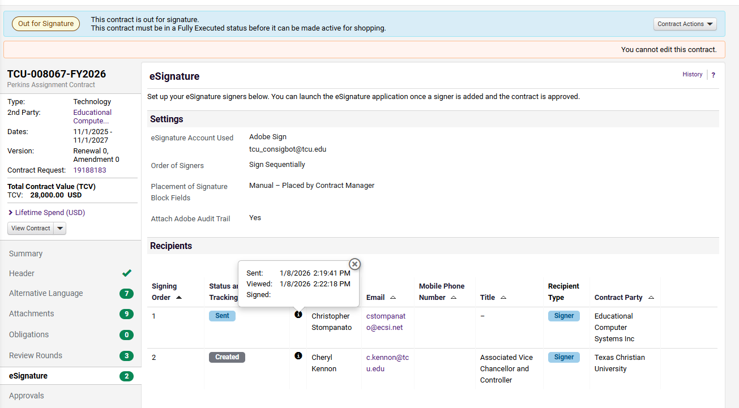
Out for Signature
Click on the Small “i” for information.
Feel free to follow up with your Supplier.

Slide 41

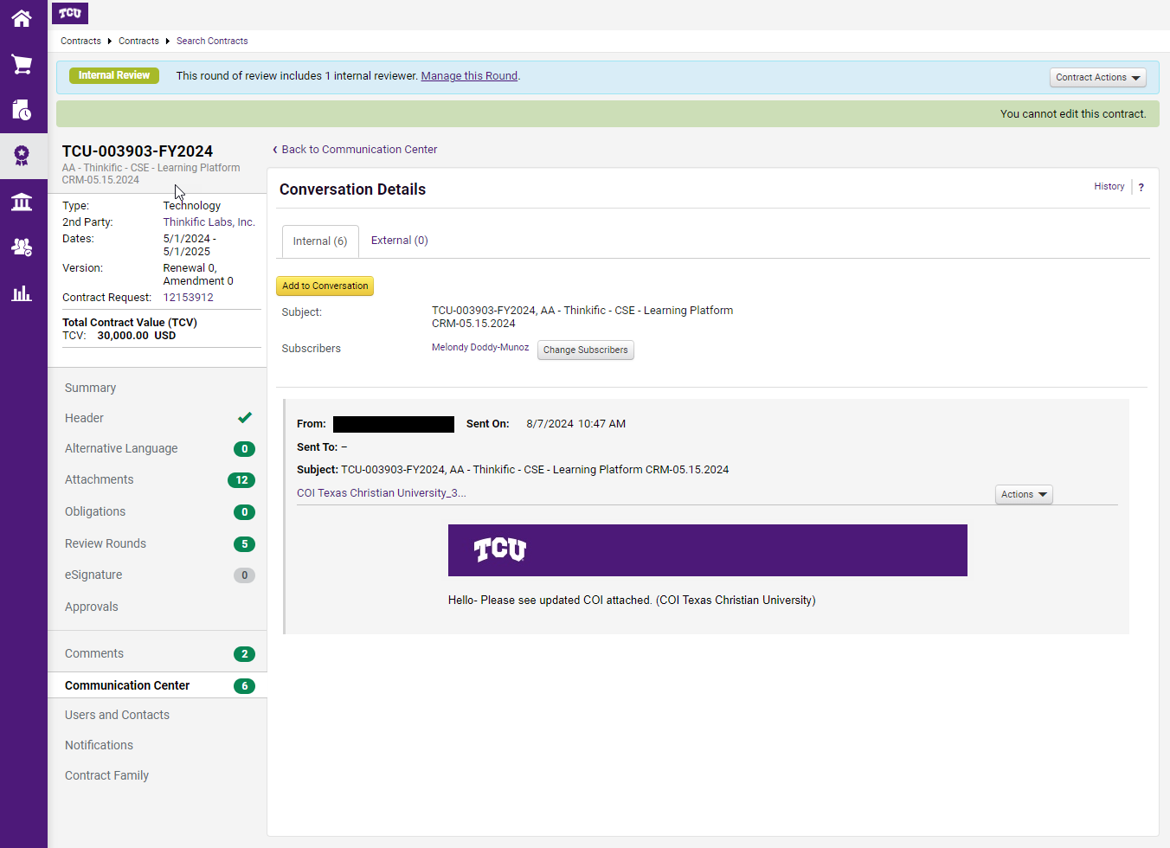


COMMUNICATION CENTER
Use the Communication Center to contact the manager, not the Comments section.
Always add a recipient to the email.
The email will be sent to EVERYONE in the “Sent To” line.

Slide 42
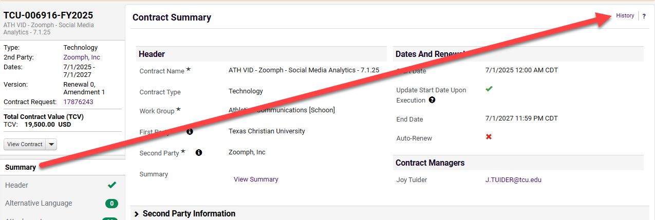

Monitoring Your Contract
Check the History!
Beyond simply checking the status, Contract Requestors can also check the history.
Go to the Summary tab on the left and select History in the top right.
Why specifically Summary?

Slide 43
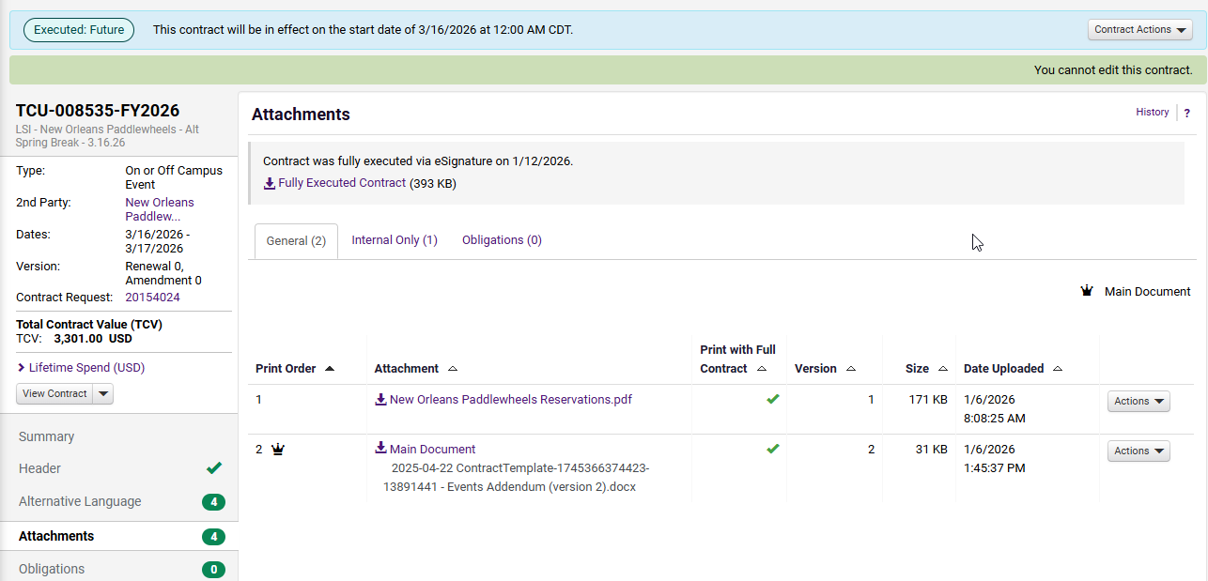
Executed Contracts
Once you see this header, you’re done! You can begin to use your services.
If you ever need a copy of your contract, go to Attachments and download the finalized PDF.

Slide 44


Questions?
Procurement
Contracts
Accounts Payable
Risk
Supplier Request
Supplier Portal
Purchase Orders
TCU Credit Cards
Other payments
procurement@tcu.edu
Contract Request
Contract File
Contract_Questions
@tcu.edu
Payment Requests
Checks
Other Payments
apinvoices@tcu.edu
Certificate of
Insurance
askrisk@tcu.edu

Slide 45

Congrats!

